Slide 1
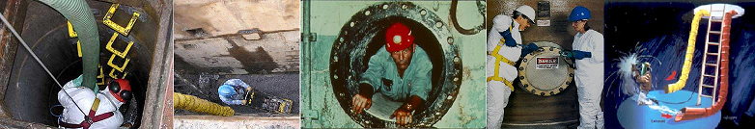
Confined Space
Hazard Analysis
WAC 296-809
Jeff Spann (253)208-6829
Industrial Hygiene Consultant
spaj235@lni.wa.gov
November 2019

Slide 2
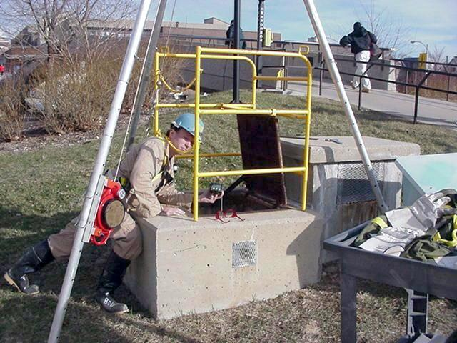
Objectives
Training Topics:
Criteria for Confined Space
Hazards
Controlling Hazards
Permits
Rescue

Slide 3
Why is it important to know about confined spaces?
Every year, about 65 workers die in confined spaces
Almost all of them hadn’t been trained on the dangers
In almost every case, no one tested the air or ventilated the space

Slide 4
NIOSH Statistics
Confined space deaths:
33% had the title of supervisor
60% were trying to rescue someone else
64% entry was unnecessary
66% involved in water, wastewater treatment, or sewer construction
78% had oxygen deficient atmosphere
95% were untrained
100% had no ventilation
100% had no test equipment

Slide 5
How do I avoid becoming a statistic?

Slide 6








Confined Space Commandments
1. Know the Hazards
2. Don’t enter if you can
avoid it
3. Test the air
4. Ventilate
(95% untrained)
(64% unnecessary)
(100% didn’t)
(100% didn’t)

Slide 7
Designing a Confined Space plan
Step 1:
Facility managers identify confined spaces

Slide 8
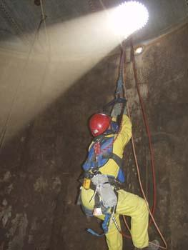
Definition of a Confined Space
  Can be entered bodily
  Limited ability to exit
  Not designed for continuous human occupancy
Notes:
This is the thing to focus on when you’re thinking about whether a space is “confined”

Slide 9
Definition of a Confined Space
  Can be entered bodily
  Limited ability to exit
  Not designed for continuous human occupancy
Notes:
This is the thing to focus on when you’re thinking about whether a space is “confined”

Slide 10
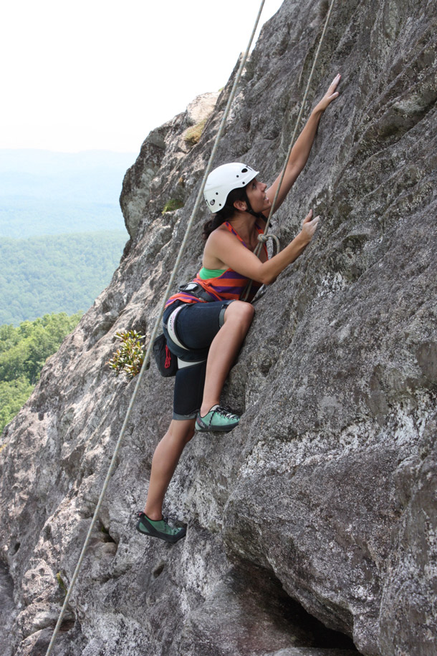

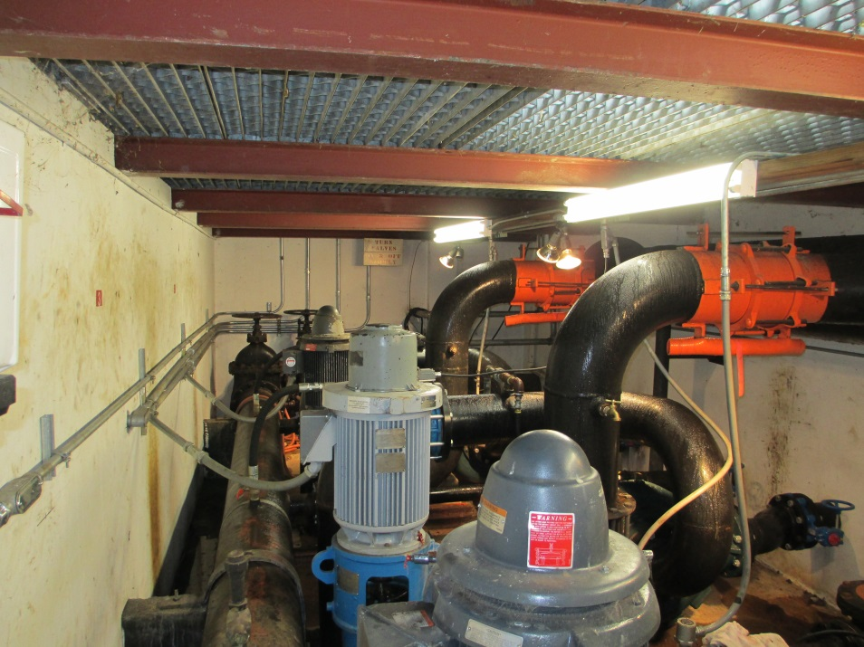
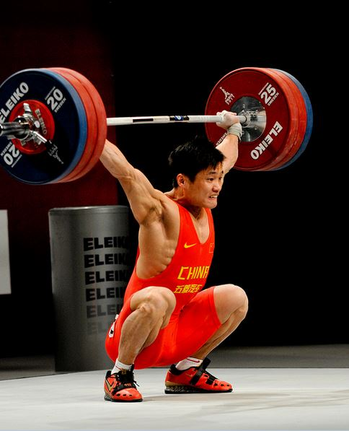
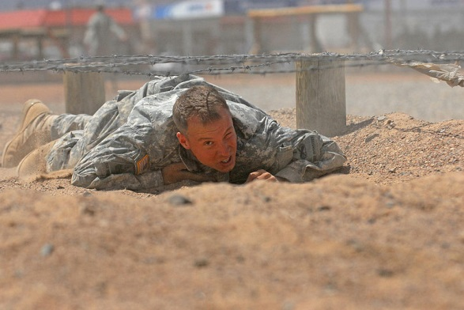
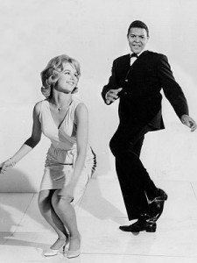
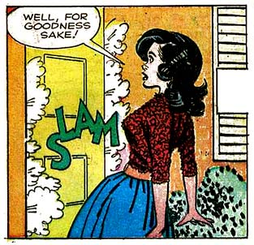
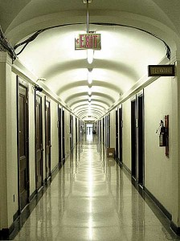
Limited ability to exit:
If you have to:
  Crawl
  Climb
  Twist
  Work around obstructions
  Walk a long distance
  Exert unusual effort
  Pass through a narrow opening
Or
  If the opening may become sealed on its own
ANYTHING THAT MAKES IT HARDER
TO RESCUE AN INJURED WORKER
Notes:
This is the thing to focus on when you’re thinking about whether a space is “confined”

Slide 11
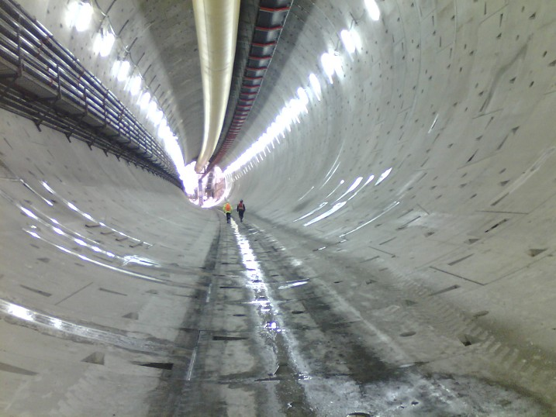

Slide 12

If it’s anything more difficult than:
It’s a confined space
Notes:
This is the thing to focus on when you’re thinking about whether a space is “confined”

Slide 13
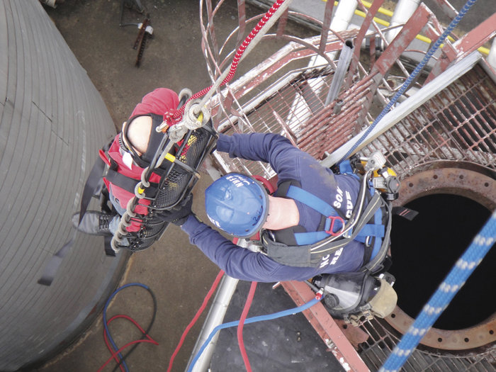
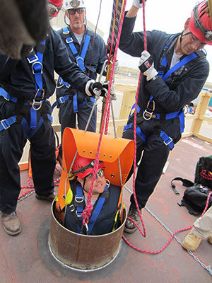
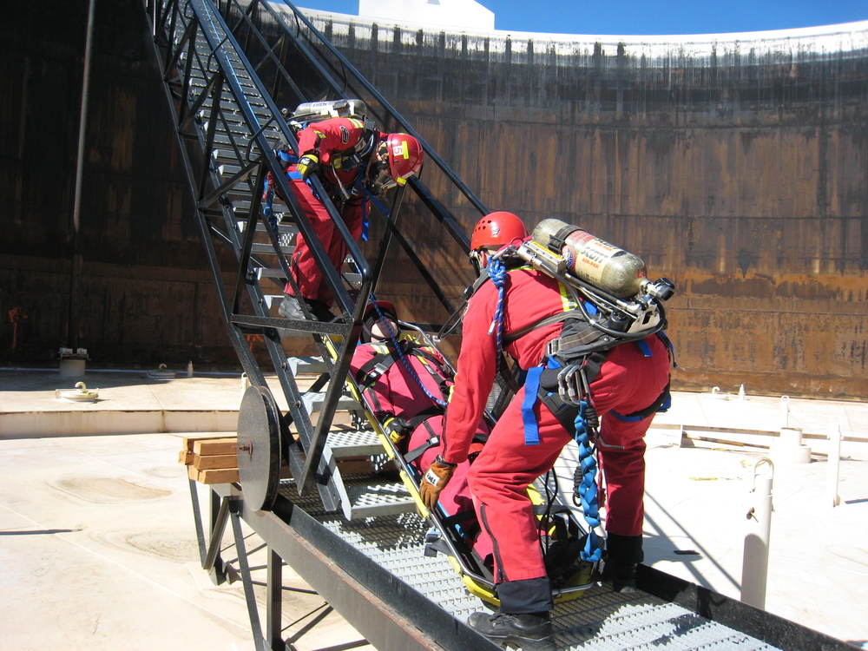
Why is that important?

Slide 14
Confined space:
Examples

Slide 15
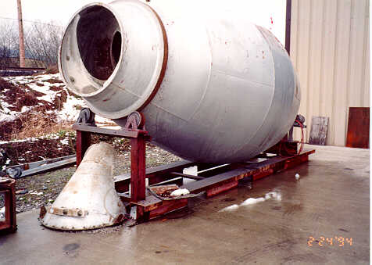
Notes:
Are the following things confined spaces?
A concrete mixer----YES

Slide 16
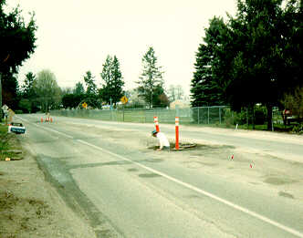
Confined Space
manhole.jpg:
worker exiting sewer manhole; many problems
Notes:
Manholes are always considered confined spaces
All manholes should be considered Permit-Required Confined Spaces, because there’s always a potential for a hazardous atmosphere in an underground space with no ventilation

Slide 17
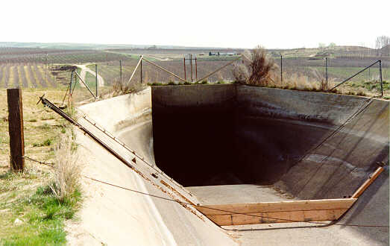
Notes:
The entry to an underground irrigation canal
Even though you could walk out of it (if it’s not full of water!), it’s more than a quarter mile long---this makes it difficult to exit.
This is the Roza irrigation canal in eastern Washington where 4 people died due to failure in planning an entry and the subsequent rescue attempt. Here’s the story:
This “siphon” drops down about 180 feet into the valley and up the other side. Some junk cars had been dumped in the siphon, and other debris had gotten stuck where they ended up at the low spot and it was all beginning to obstruct water flow. With the canal full of water, the irrigation district sent two divers down to hook a cable to the cars and pull all the debris out. The divers weren’t professionals; they had just been SCUBA-certified in a recreational dive class. They asked how deep the canal was, and were told it was 13 feet. They set their dive computers for this depth, which told them they had something like an hour’s worth of air. No one thought about the fact that the water at the bottom really had a 180-foot column of water compressing it (the siphon slopes down very gradually, so they didn’t notice that they were descending), and their air only lasted 15 minutes or so.
When the 2 divers didn’t return, the employer called 2 other people who were known to be SCUBA-trained to rescue them. They came out to the site, got their gear on---and made the same mistake the first 2 divers made. Their air ran out when they were too far into the siphon, and all 4 divers drowned.

Slide 18


Slide 19
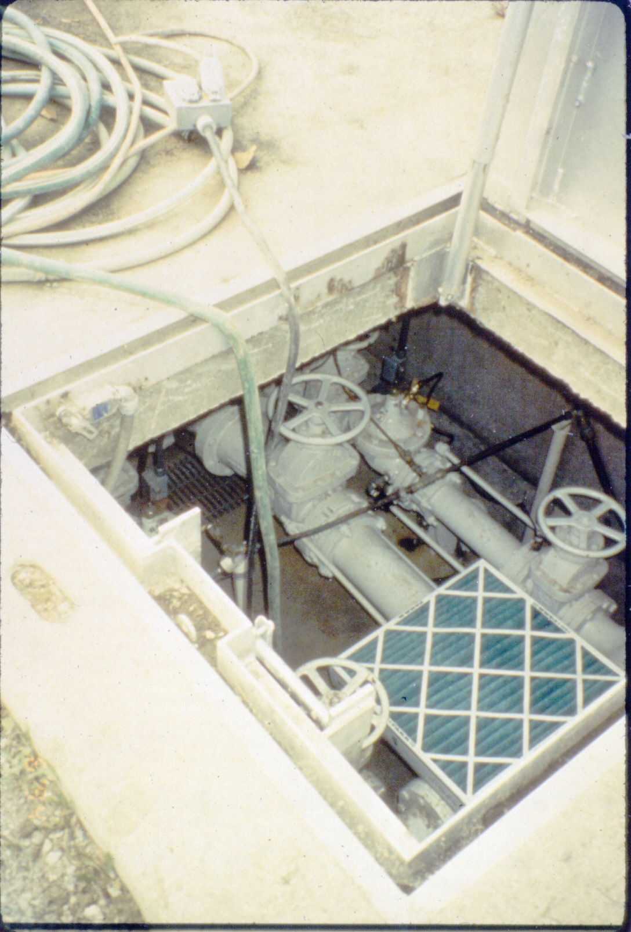
Notes:
An underground pipe vault
Depends on how deep it is --- Do you just reach your hand in & turn a valve? Are there obstructions to climb around that you could get stuck in and make it difficult to rescue you? Typically they fit the definition of confined space.
There is at least one record of a death from a worker just putting his head into an underground vault.

Slide 20
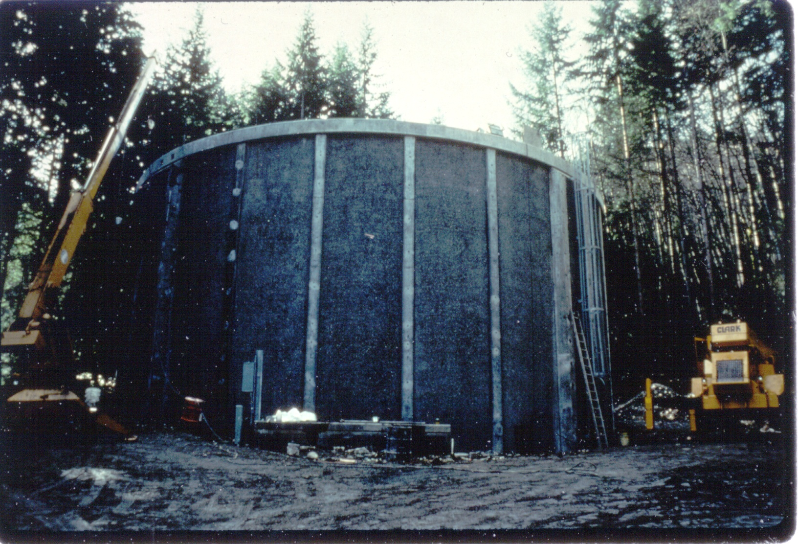
Notes:
A water tank
Note the ladder up to an access point halfway up the right side
These almost never have ordinary easy exits
During a renovation on one of these, the contractor cut a ground-level door big enough to drive a manlift through---they needed access to the top of the walls and it was easiest to cut a hole and repair it afterward.
This made it temporarily NOT a confined space. <<<ask what problem they still had to deal with?-----carbon monoxide---they were using a propane-powered manlift; they finally ran an exhaust hose outside, and measured CO to make sure they weren’t getting leaks>>> ---even though it wasn’t a confined space in terms of rescue, there was still a strong potential for a hazardous atmosphere.

Slide 21
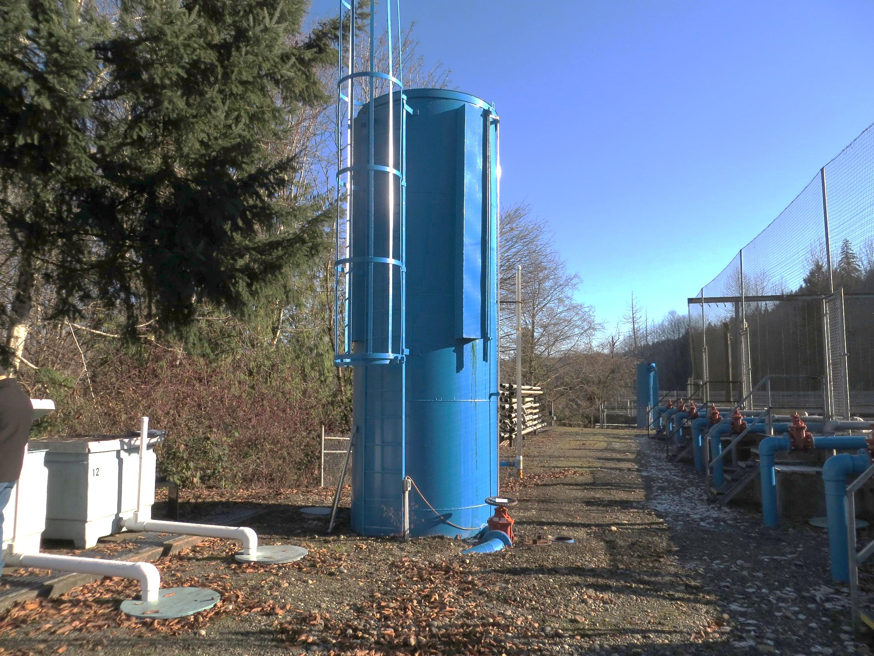

Slide 22
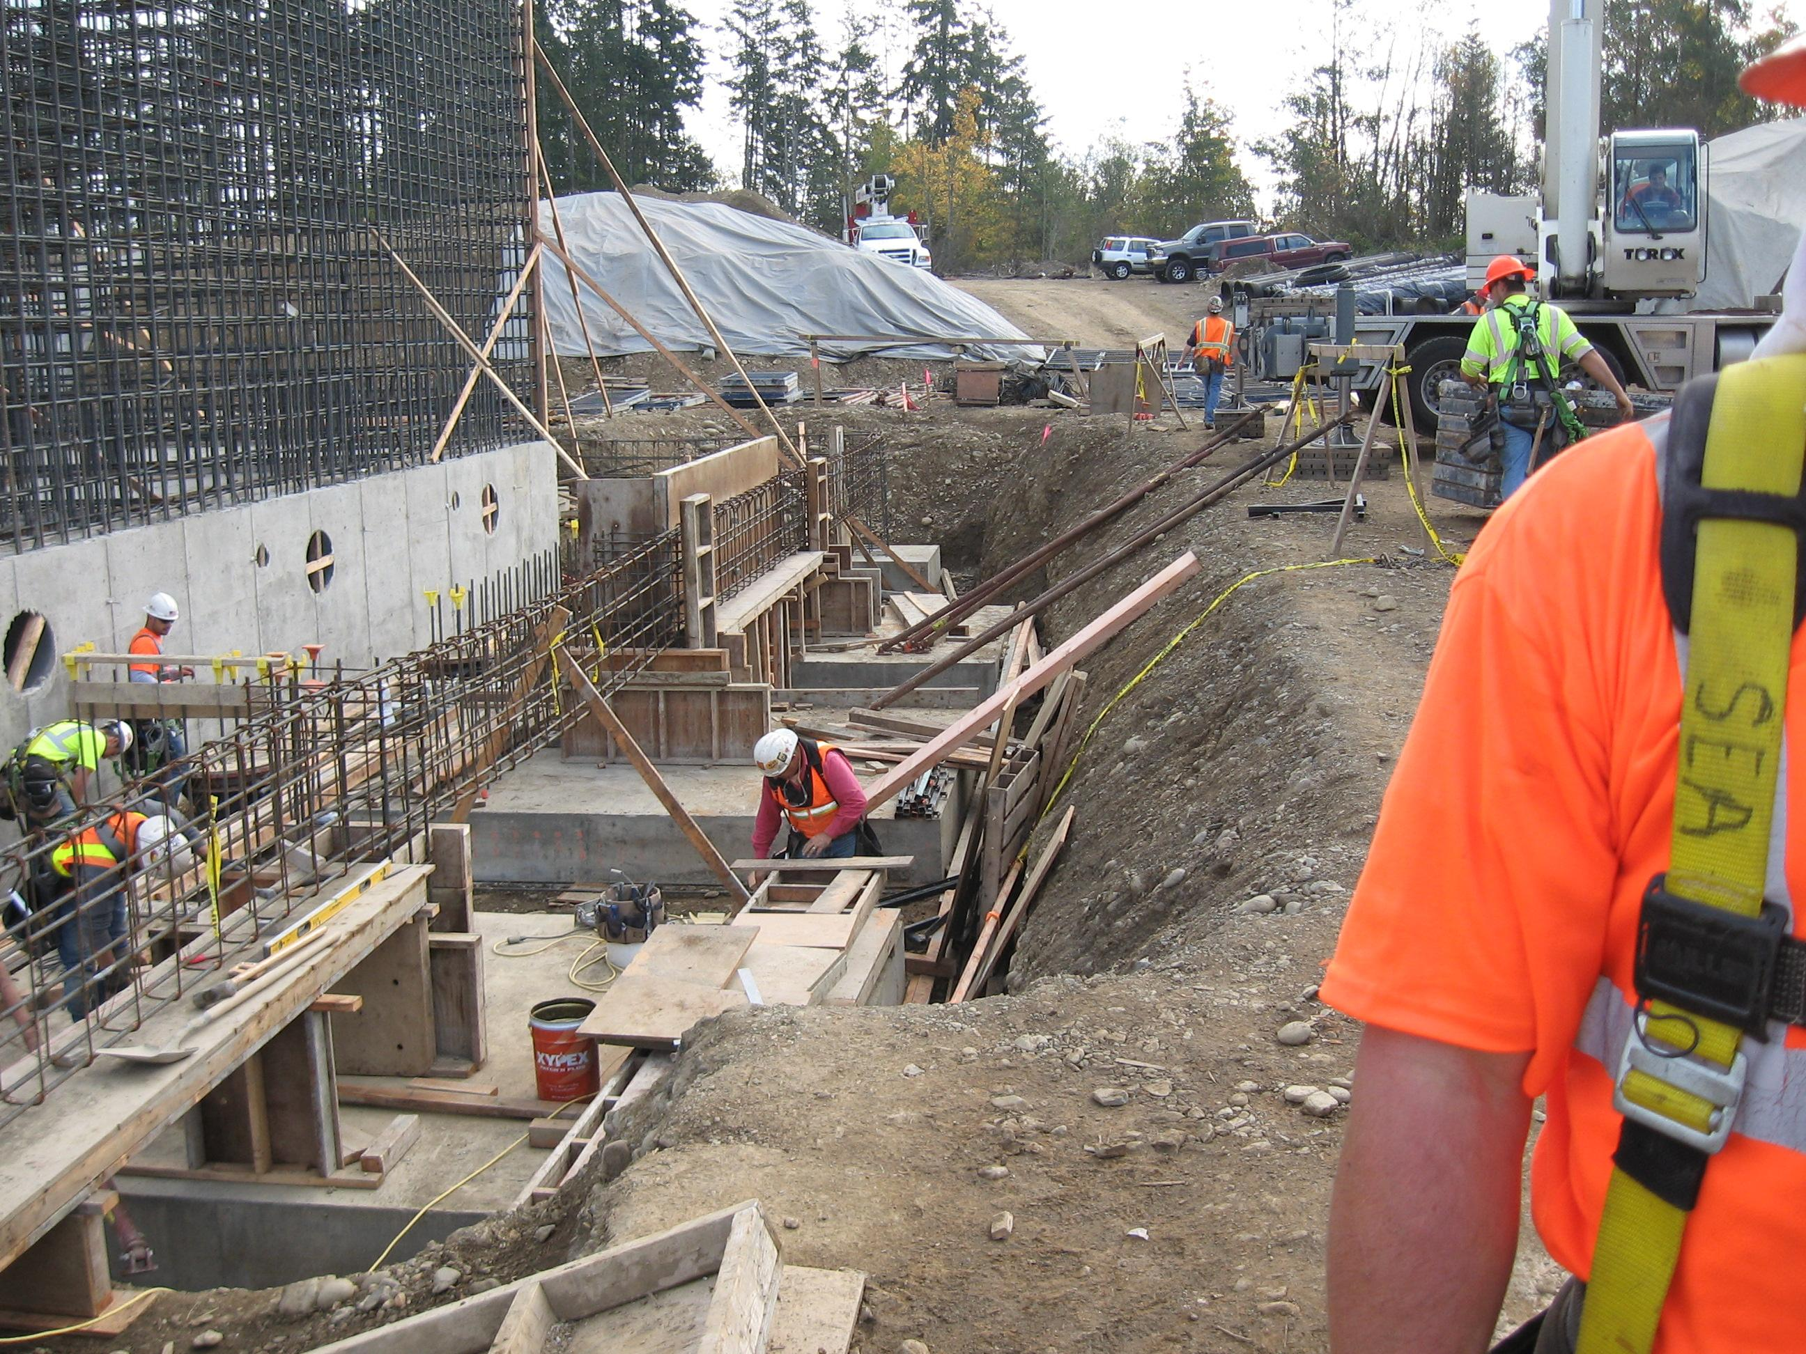
Notes:
A bit of climbing to get out---and could be overcome by solvent vapors, or have unsecured equipment drop on him.
…NOW WE’RE STARTING TO TALK ABOUT WHAT HAZARDS EXIST IN CONFINED SPACES-----THE ONES THAT ARE IMPORTANT TO THINK ABOUT ARE THE ONES WHERE HAZARDS EXIST

Slide 23
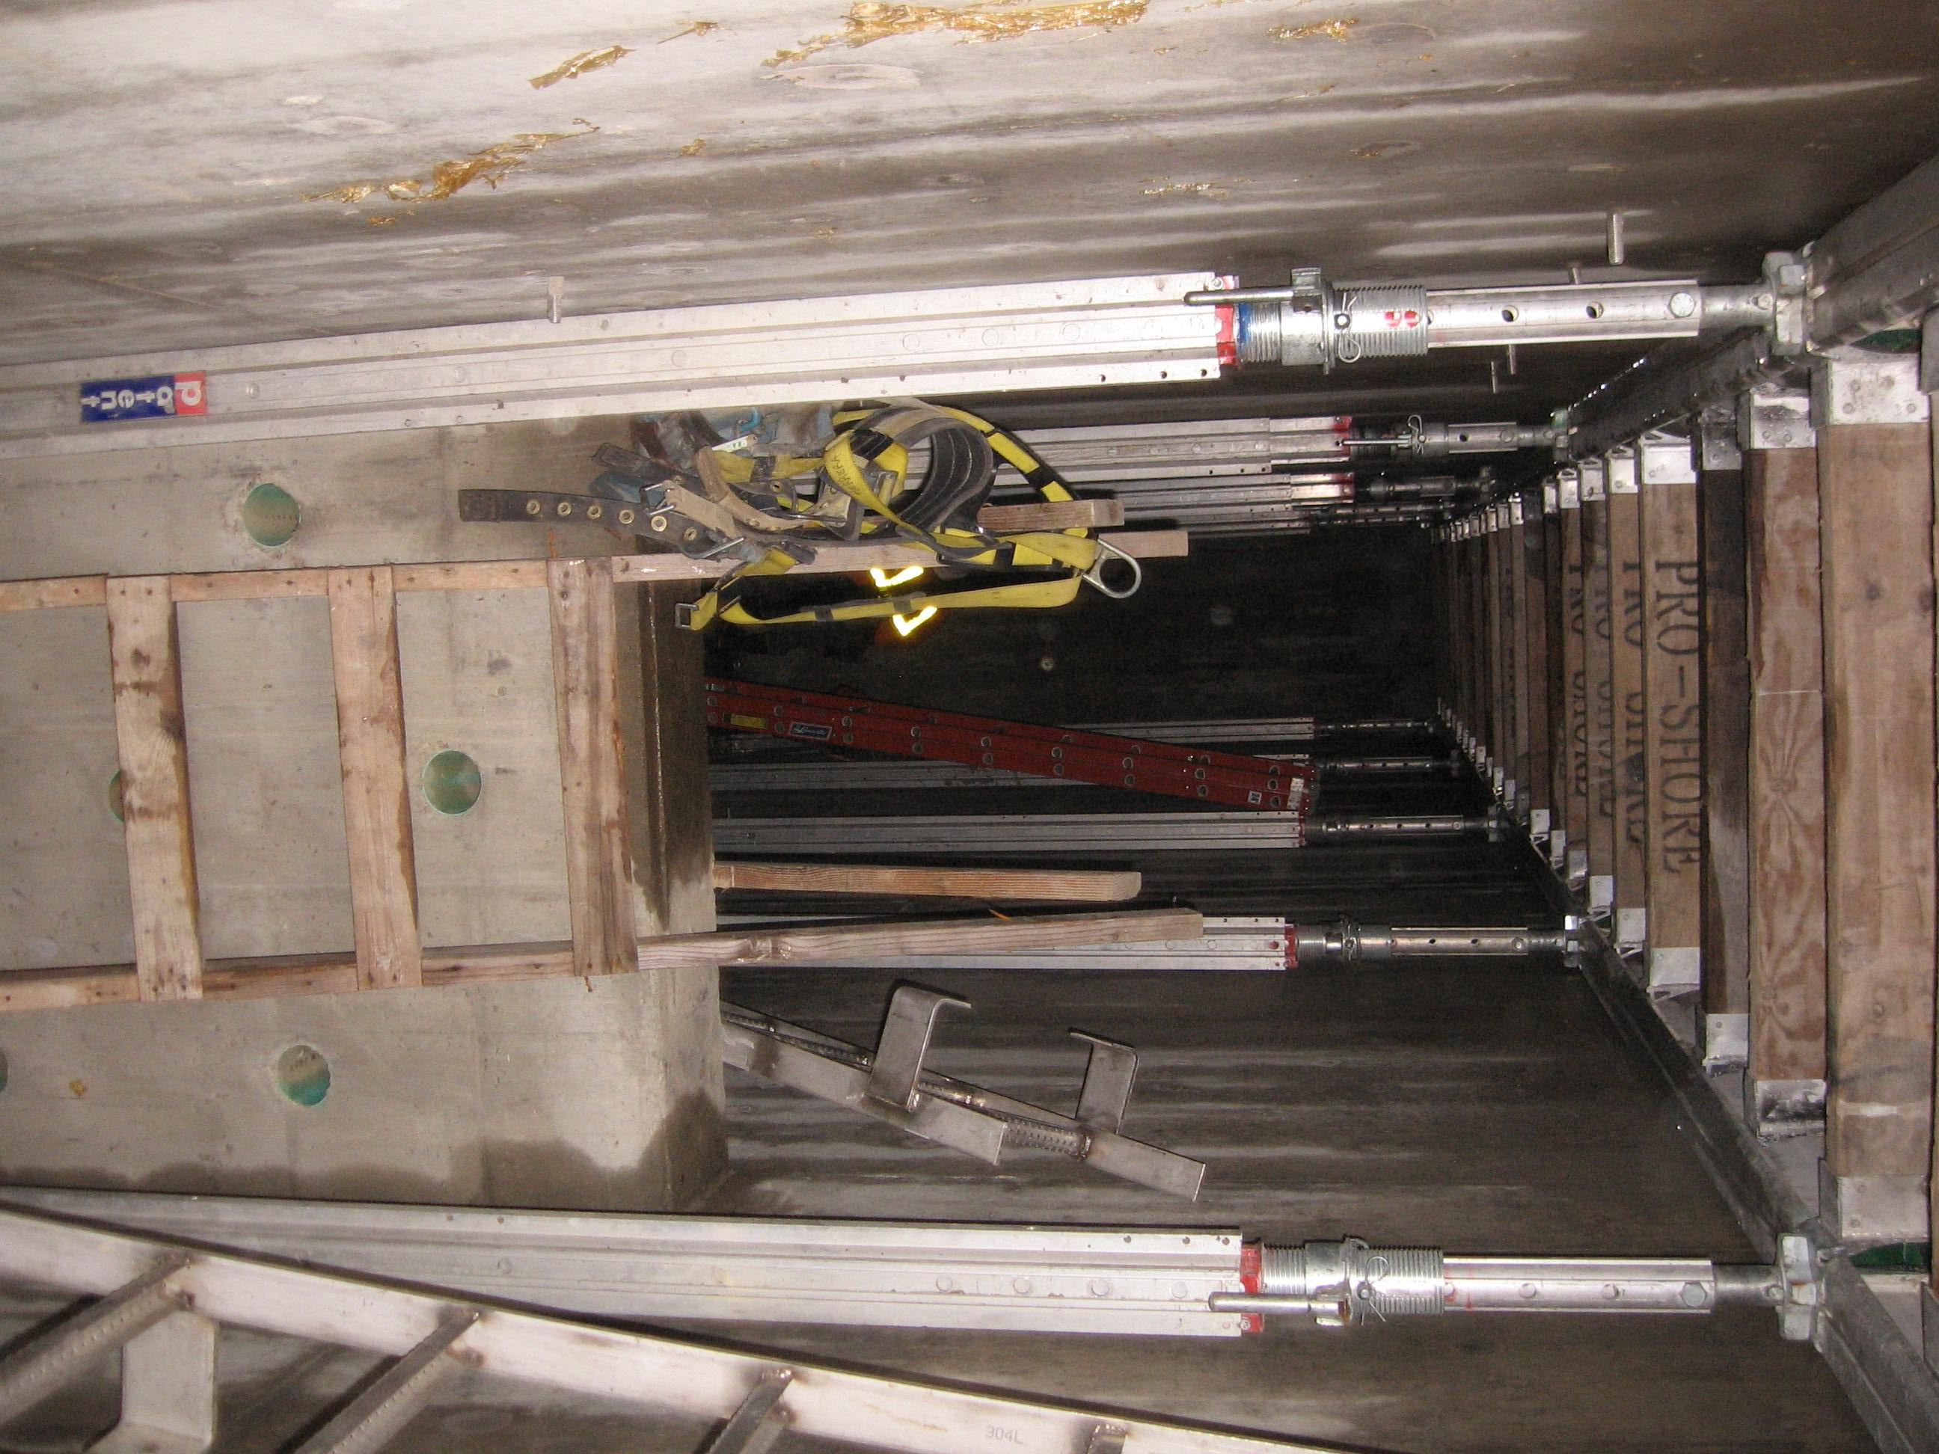
Notes:
A bit of climbing to get out---and could be overcome by solvent vapors, or have unsecured equipment drop on him.
…NOW WE’RE STARTING TO TALK ABOUT WHAT HAZARDS EXIST IN CONFINED SPACES-----THE ONES THAT ARE IMPORTANT TO THINK ABOUT ARE THE ONES WHERE HAZARDS EXIST

Slide 24
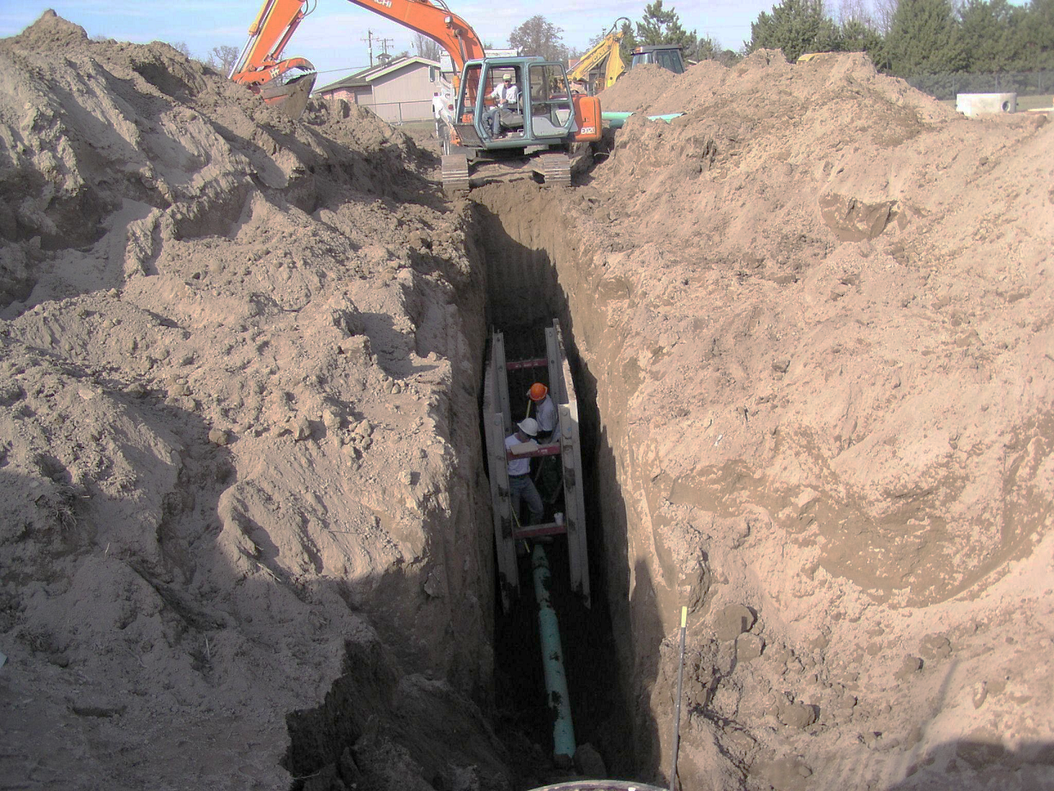
Notes:
A trench ---- Yes
What else is wrong with this picture?

Slide 25
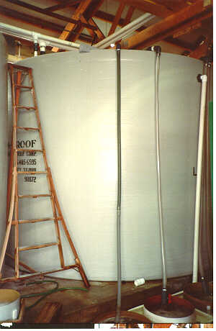
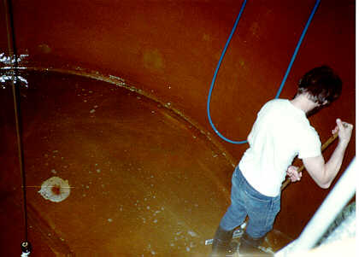
Notes:
Putting a coating on the inside of a tank
What do you think of the way he got into the tank?

Slide 26
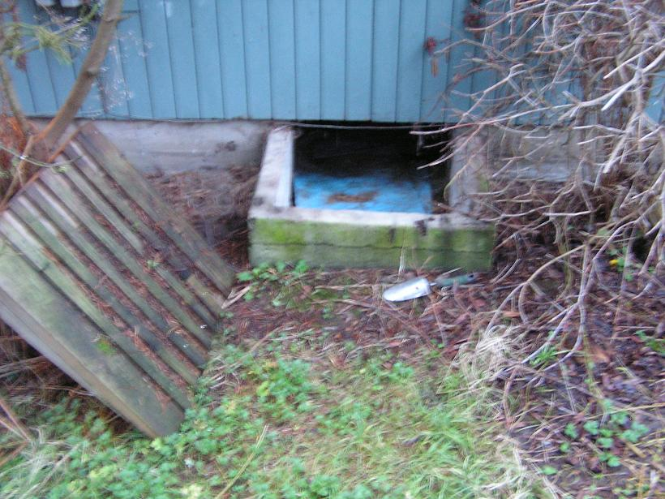

Slide 27
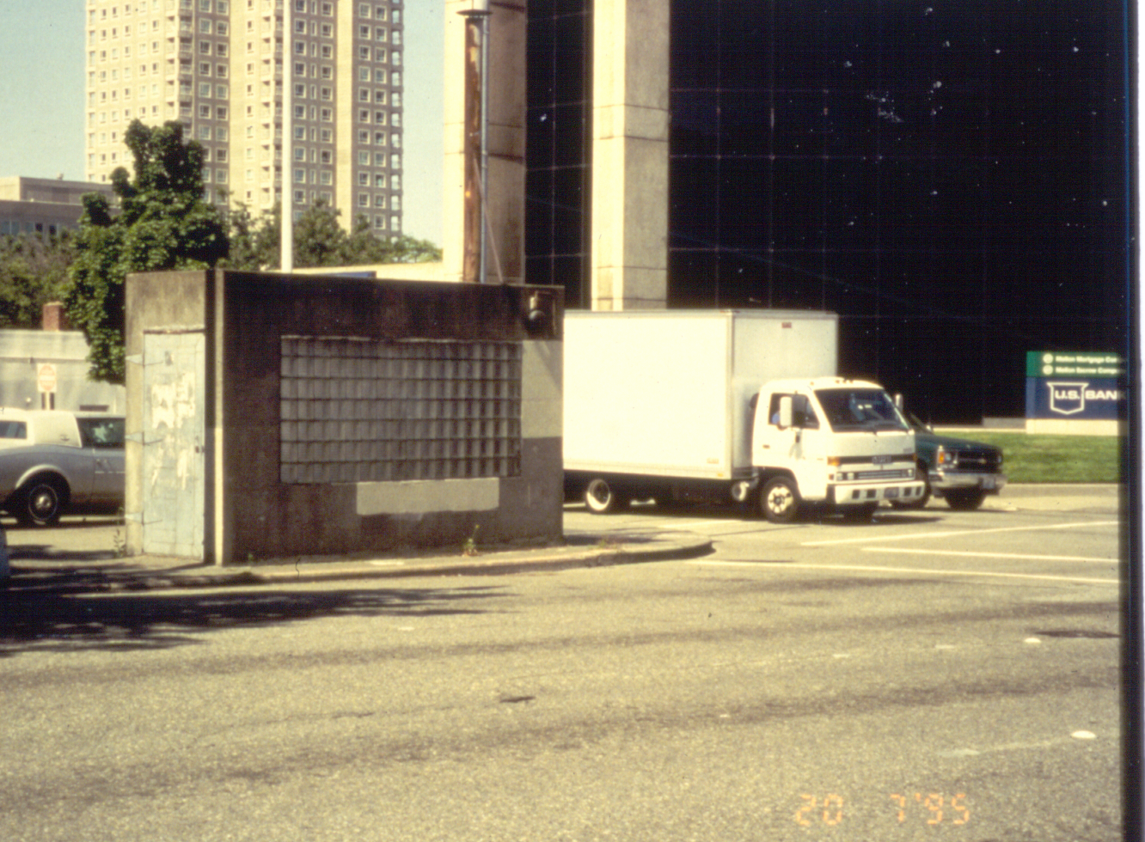
Notes:
Above-ground electrical vault
It has a normal door---but what’s inside? Equipment configuration could make it hard to get out by yourself (or worse—having to drag someone out) in case of a problem

Slide 28
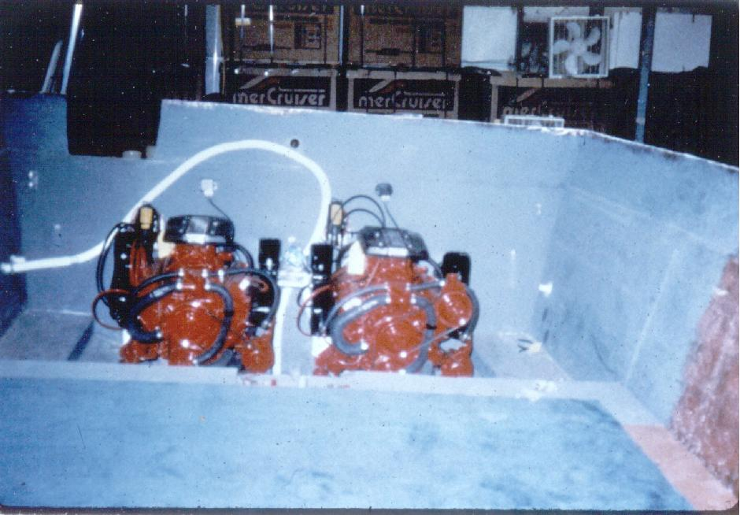
Notes:
Boat hull under construction
Pretty wide open, but….

Slide 29
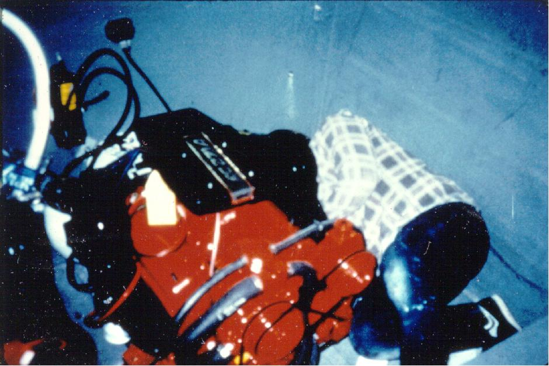
Notes:
A bit of climbing to get out---and could be overcome by solvent vapors, or have unsecured equipment drop on him.
…NOW WE’RE STARTING TO TALK ABOUT WHAT HAZARDS EXIST IN CONFINED SPACES-----THE ONES THAT ARE IMPORTANT TO THINK ABOUT ARE THE ONES WHERE HAZARDS EXIST

Slide 30
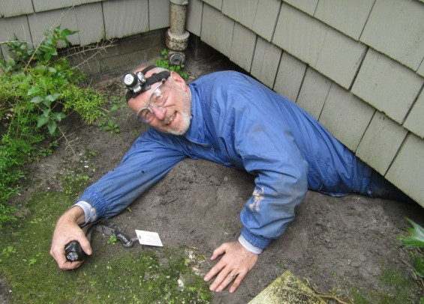

Slide 31
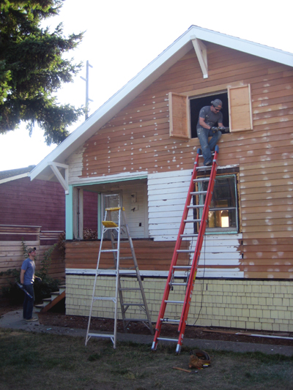

Slide 32
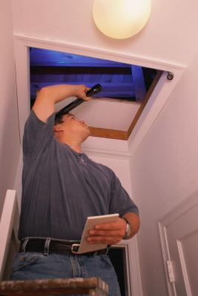

Slide 33
Designing a Confined Space plan
Step 1:
Facility managers identify confined spaces
Step 1a:
Assume that all confined spaces are Permit-Required
until proven otherwise

Slide 34
Permit-Required Confined Space
Evaluate & control hazards
Entry permit
Proper safety equipment
Provide for rescue
Prevent unauthorized entry
Entry supervisor, attendant, entrant
Training
Air monitoring
keep & review
(non-entry)
(usually)
Notes:
WHY ARE HAZARDOUS ATMOSPHERES THE MOST IMPORTANT THING TO THINK ABOUT?
They’re what’s most likely to kill you in a confined space
Atmospheric hazards are often not obvious----you have to think beforehand, and test for what might be there or be missing

Slide 35
Permit-Required Confined Space
Potential for Serious Hazard
  Anything that could incapacitate a worker…
  requiring rescue from outside
Notes:
WHY ARE HAZARDOUS ATMOSPHERES THE MOST IMPORTANT THING TO THINK ABOUT?
They’re what’s most likely to kill you in a confined space
Atmospheric hazards are often not obvious----you have to think beforehand, and test for what might be there or be missing

Slide 36




PERMIT-
REQUIRED
CONFINED
SPACES

Slide 37
Designing a Confined Space plan
Step 1:
Facility managers identify confined spaces
Step 1a:
Assume that all confined spaces are Permit-Required
until proven otherwise
Step 2:
Facility managers evaluate hazards
Step 2a:
If no serious hazards:
Non-permit space

Slide 38
Permit-Required Confined Space
Potential for Serious Hazard
  Atmospheric
  Physical
Notes:
WHY ARE HAZARDOUS ATMOSPHERES THE MOST IMPORTANT THING TO THINK ABOUT?
They’re what’s most likely to kill you in a confined space
Atmospheric hazards are often not obvious----you have to think beforehand, and test for what might be there or be missing

Slide 39
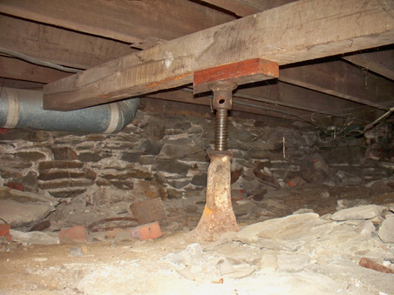

Slide 40
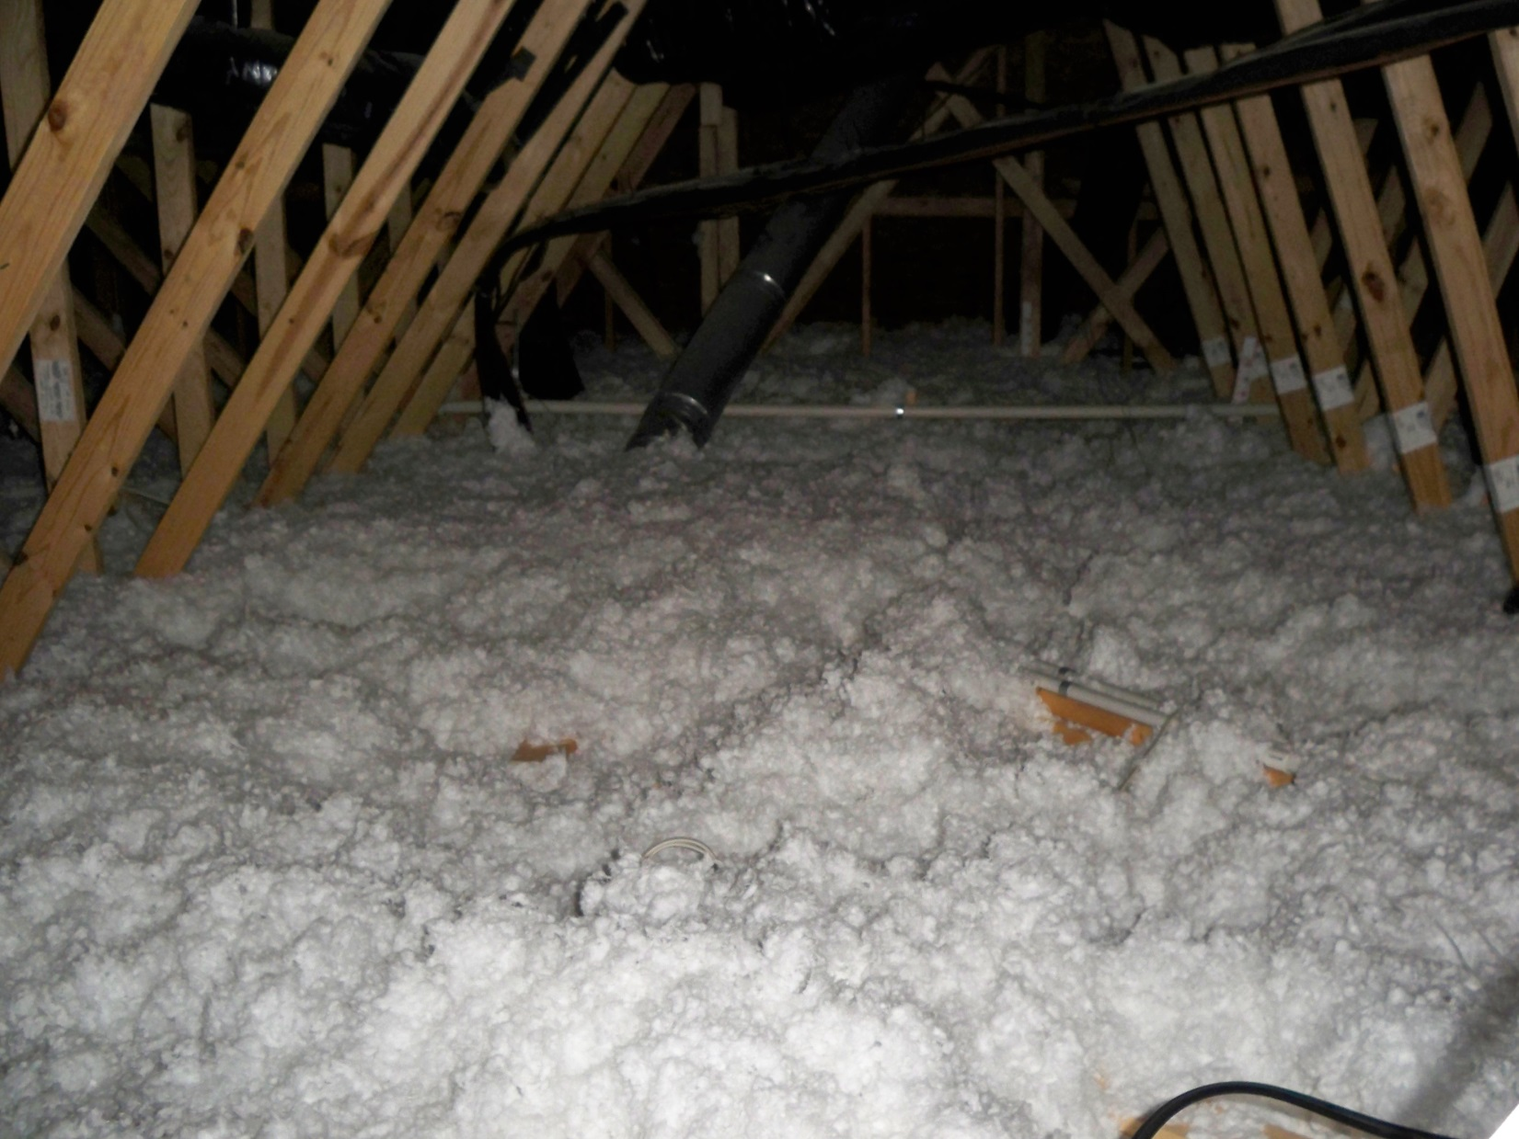

Slide 41
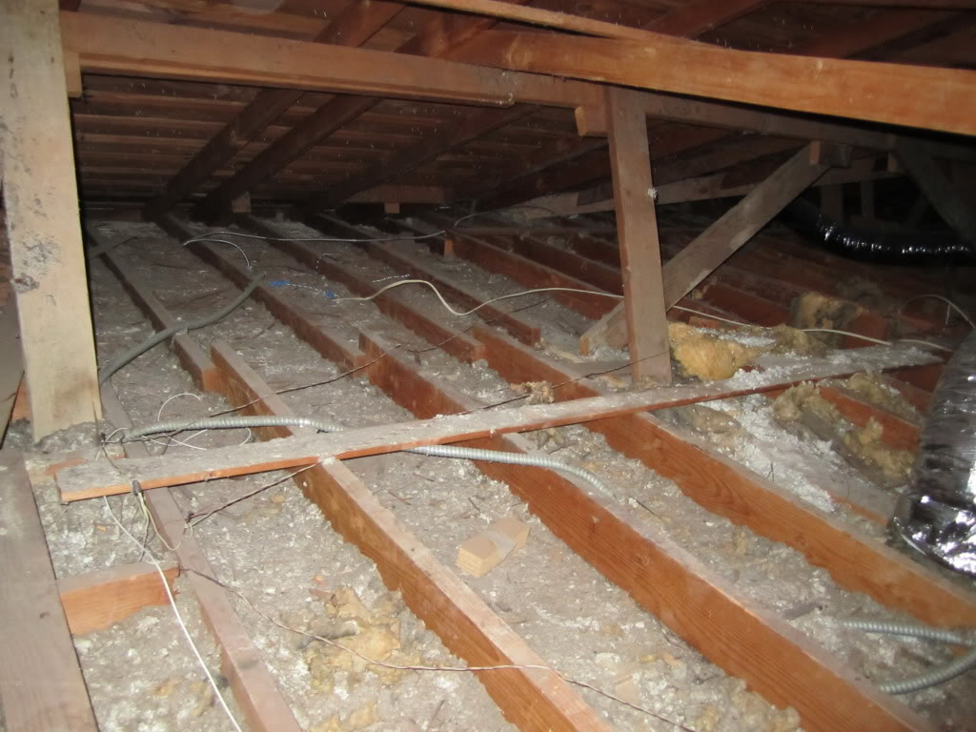

Slide 42
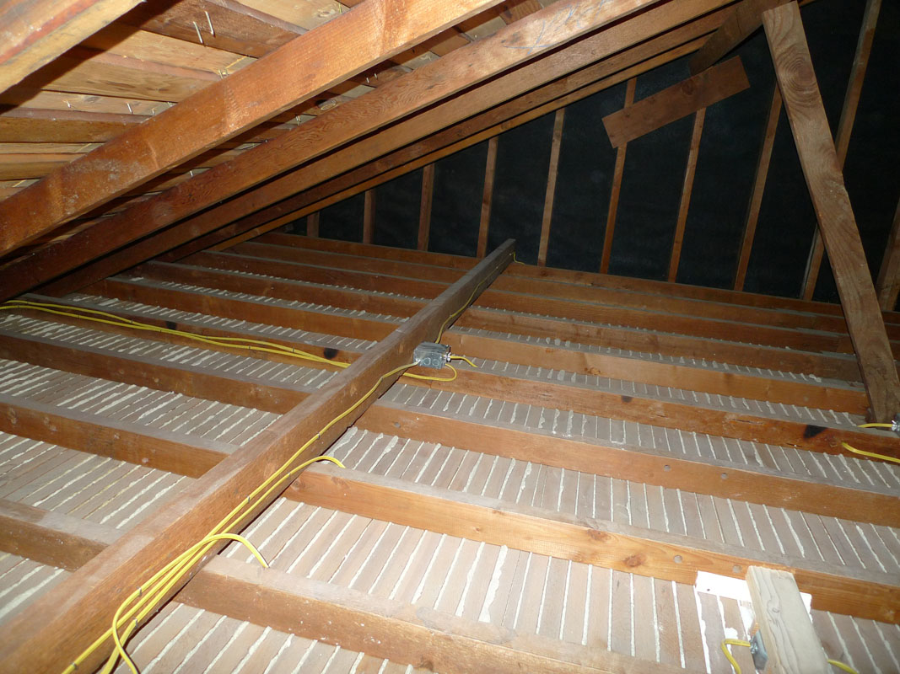

Slide 43
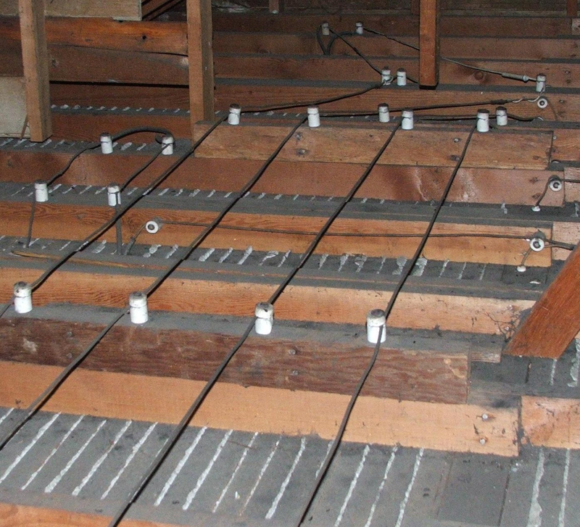

Slide 44
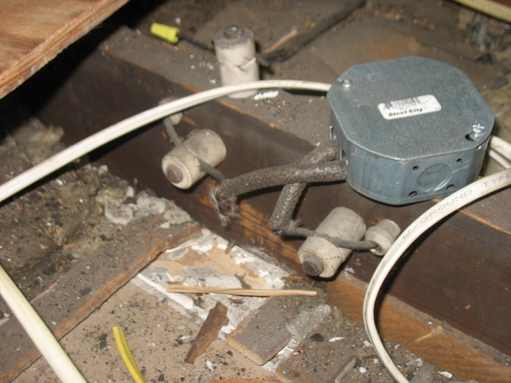

Slide 45
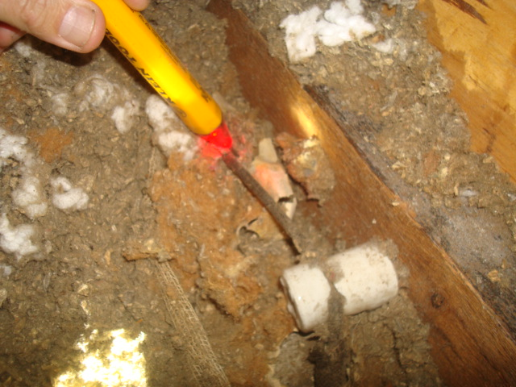

Slide 46
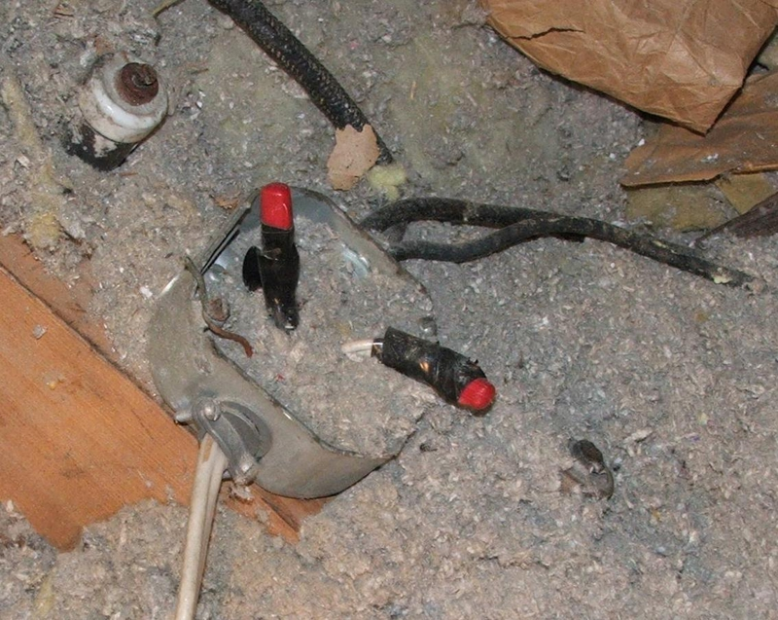

Slide 47
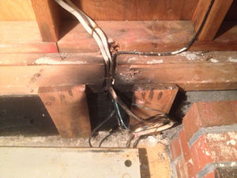

Slide 48
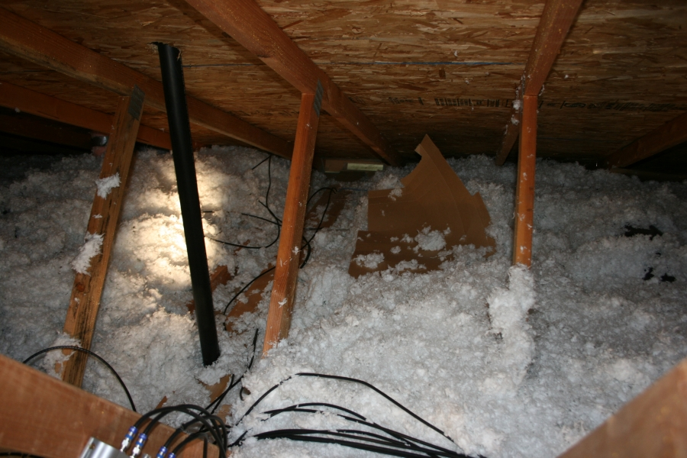

Slide 49
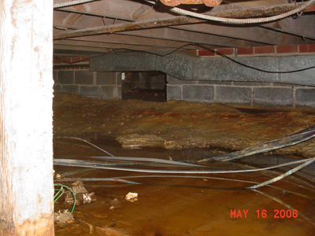

Slide 50
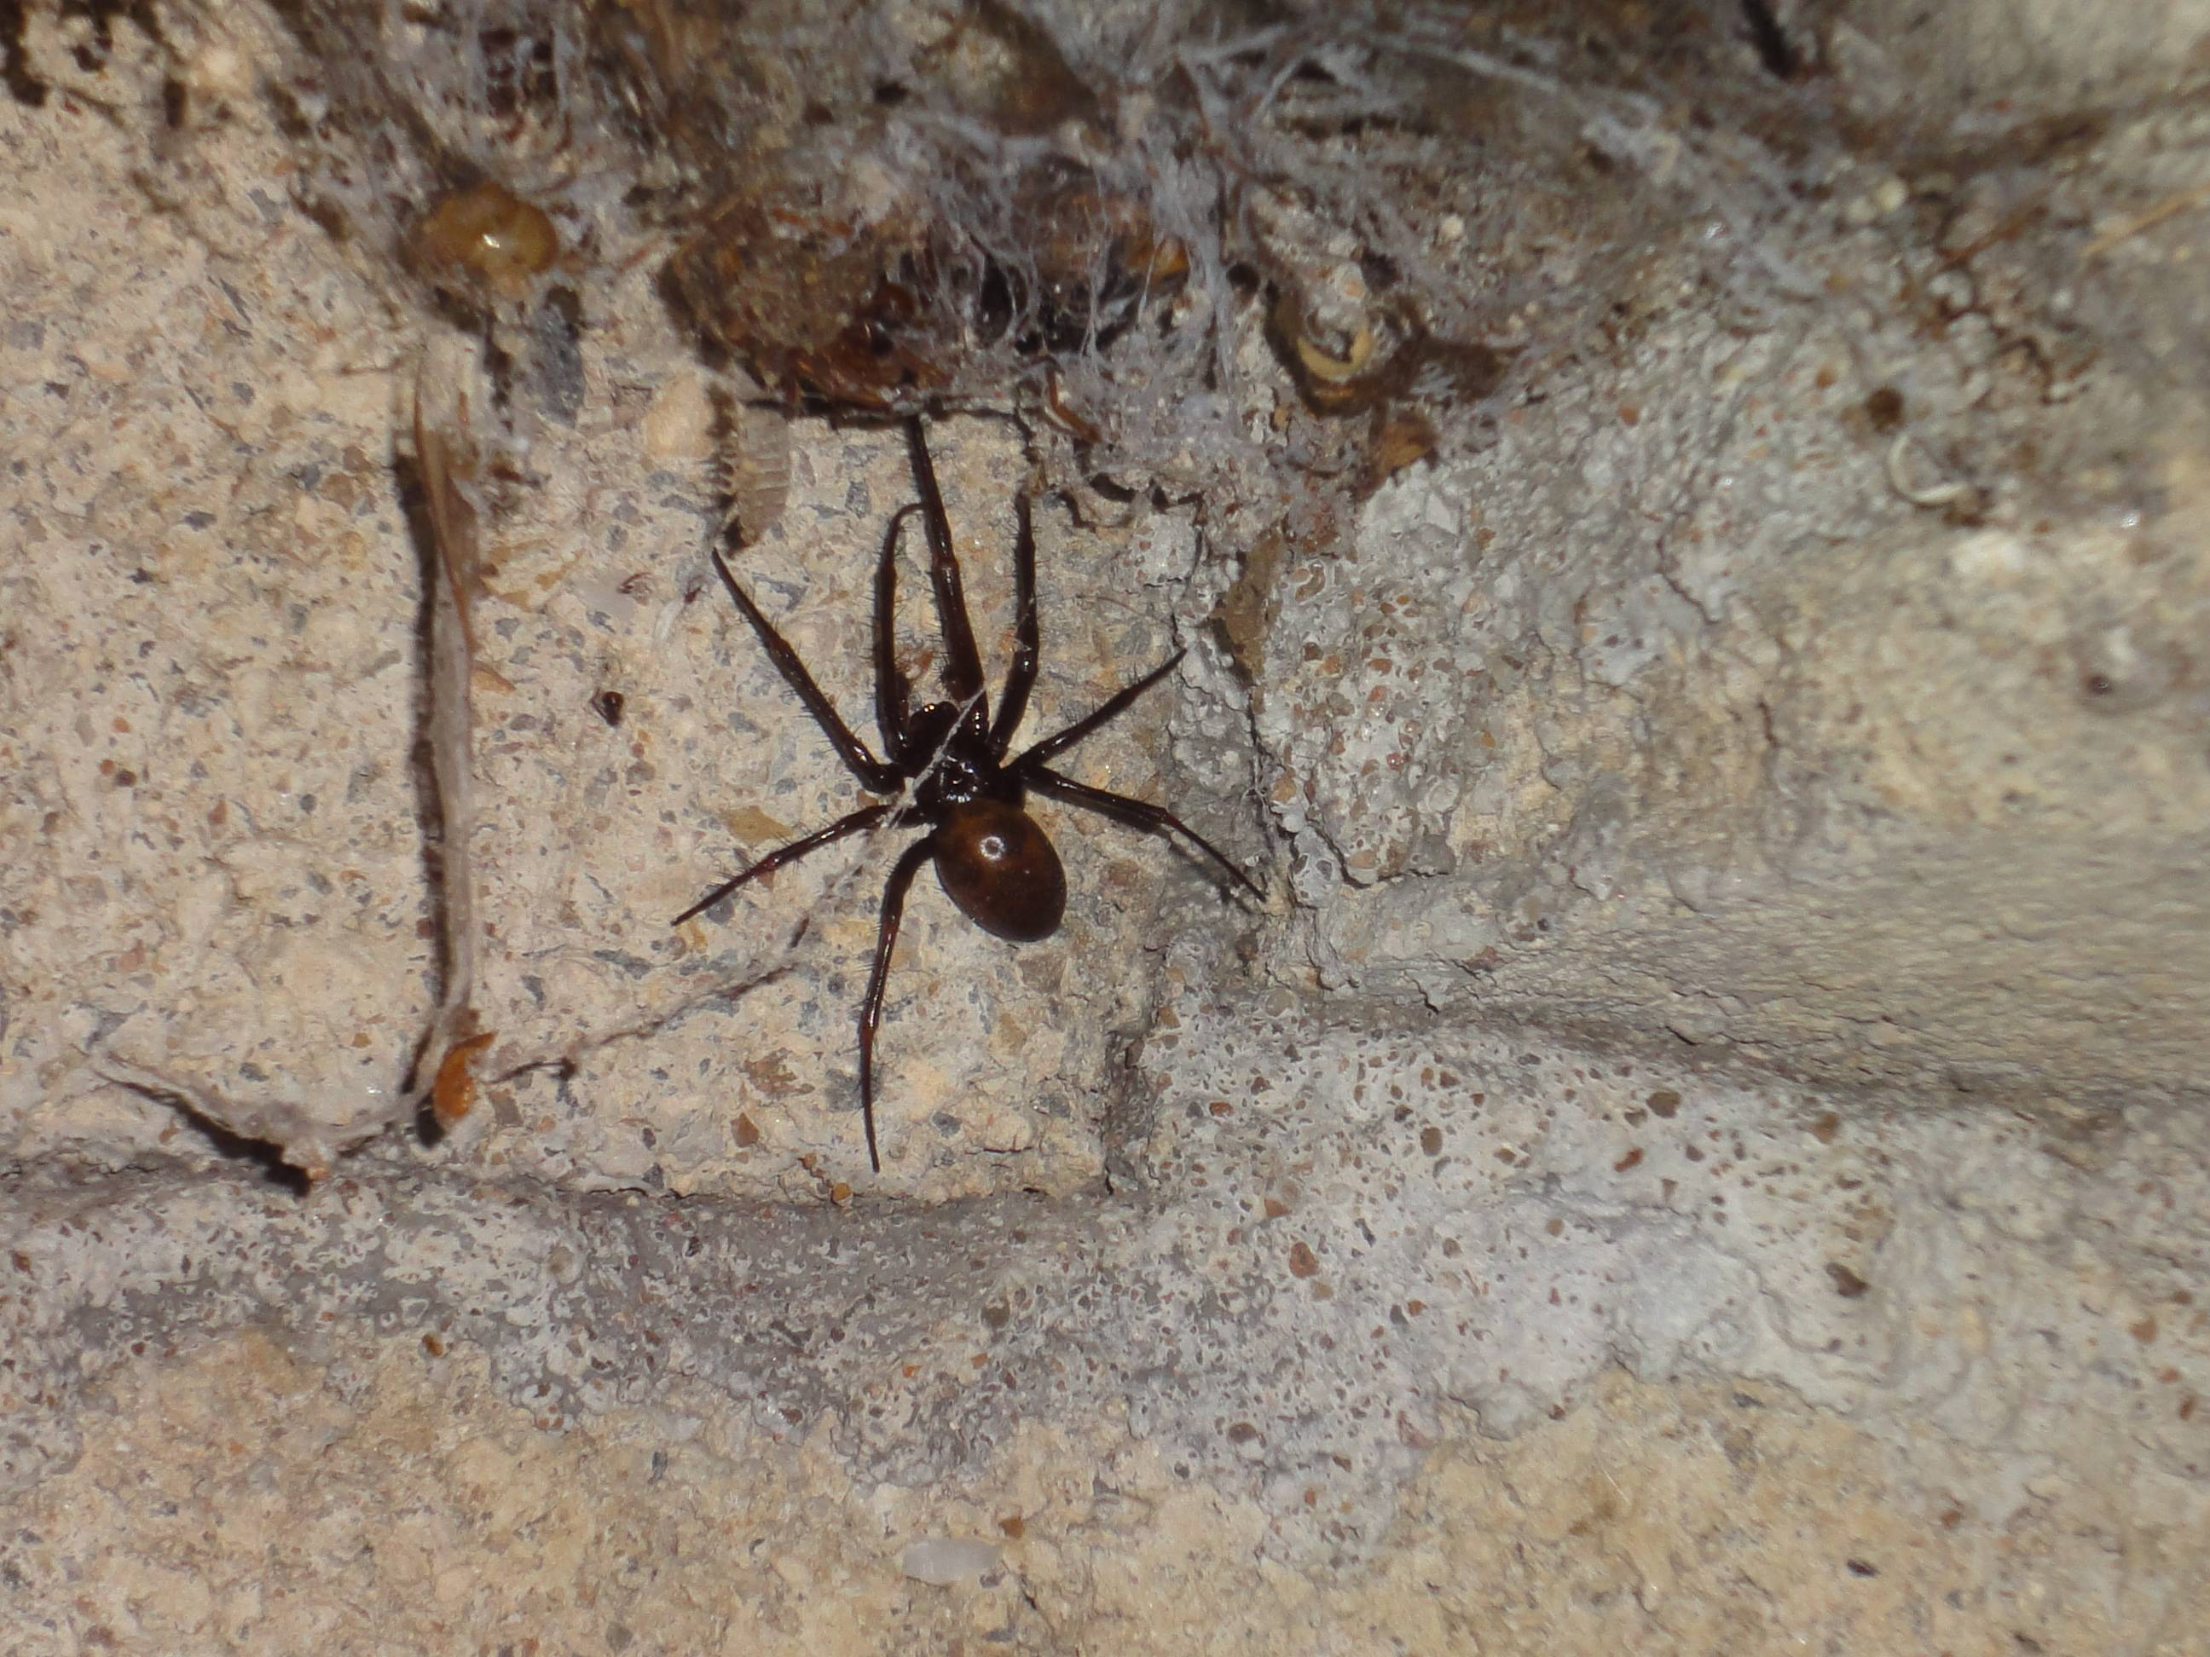

Slide 51
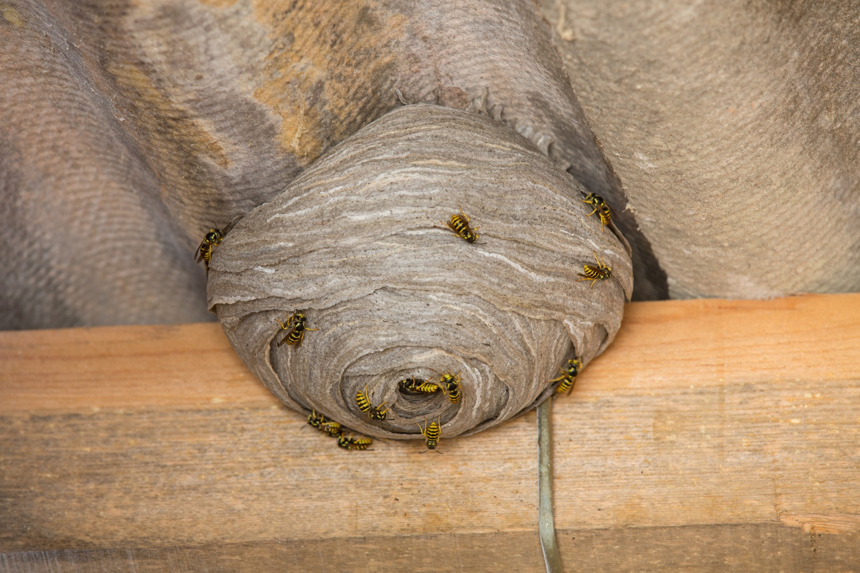
First aid?
Liquid antihistamine for allergic reactions

Slide 52
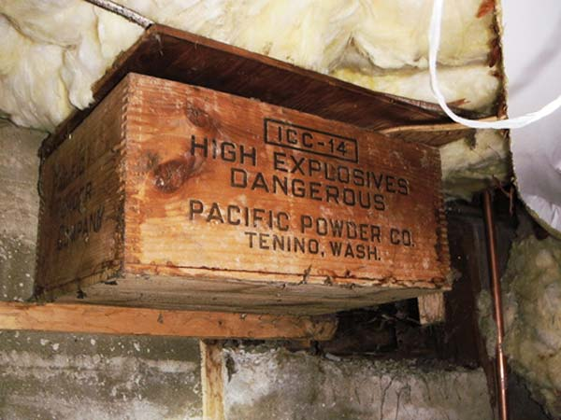

Slide 53
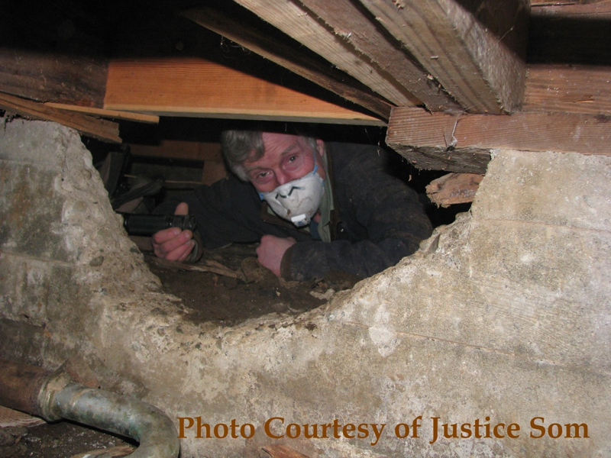

Slide 55
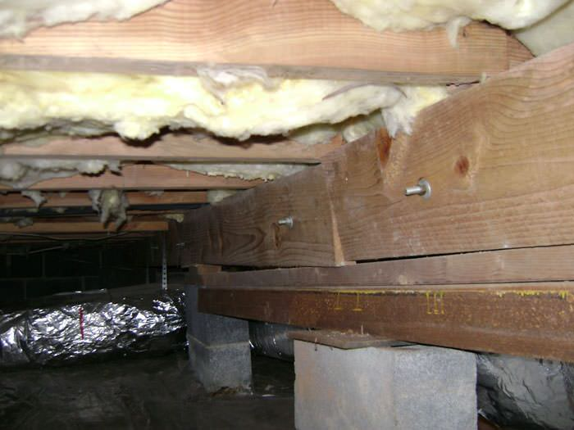

Slide 56
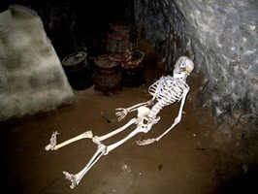

Slide 57
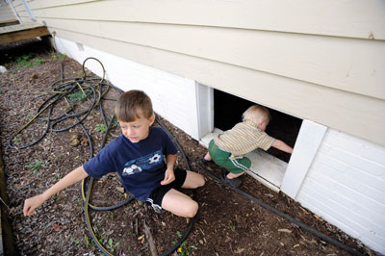

Slide 58


Slide 59


Slide 60
What can you do about heat?
Work when it’s cooler
Buddy system
Awareness training
Fans?
Open the roof?
ACGIH work/rest schedule?
Ice vests?
Extreme hydration?

Slide 61


Slide 62
Document absence of potential serious hazards
Step 3:
Document the absence of potential serious hazards
or document how you eliminate them
or describe how to eliminate them
WAC 296-809-70002
doesn’t require a “permit”

Slide 63
Designing a Confined Space plan
Step 1:
Facility managers identify confined spaces
Step 1a:
Assume that all confined spaces are Permit-Required
until proven otherwise
Step 2:
Facility managers evaluate hazards
Step 2a:
Non-permit space
If no serious hazards:
Step 3:
Document absence of potential
serious hazards
or describe how to eliminate them

Slide 64
Some documentation in written plan
Some for use at time of entry
WAC 296-809-60002 doesn’t require a “permit”
…but a pre-entry checklist is a really good idea

Slide 65

Checklists should be:
simple
brief
relevant

Slide 66


Slide 67


Slide 68


Slide 69


Slide 70
Training
Hazard recognition
Hazard elimination
  Heat stress
  Health hazard awareness

Slide 71


Slide 72


Slide 73
Vermiculite usually contains asbestos
Notes:
Vermiculite is a Mica-like mineral consisting of clay minerals that expand or “pop” when heated to form a material that is fire-resistant, chemically inert, absorbent, odorless, and lightweight. Expanded vermiculite is used in construction and consumer materials (e.g., loose-fill insulation, acoustic finishes, spray-on insulation, and concrete mixes for swimming pools), agricultural and horticultural products (e.g., potting mixes and soil conditioners) and in industrial products (e.g., brake shoes and pads, drilling muds, furnaces, and insulation blocks).
The Libby Vermiculite Mine deposit had an average asbestos content of 4 to 6 percent. Miners and millers were, at times, exposed to high levels of asbestos-containing dusts. Many workers developed health problems as a result of those exposures. Some residents of Libby who were exposed to high levels of asbestos also have been diagnosed with asbestos related symptoms. Mine was closed in 1990. Much of the asbestos-contaminated vermiculite mined in Libby, Montana, was used to produce attic insulation products.
EPA has documented exposures to tremolite asbestos greater than the PEL from handling dry product

Slide 74

Notes:
“Zonolite” was the major brand of vermiculite from Libby, Montana---where many people have developed asbestos-related diseases from exposure to mine tailings

Slide 75



Rock wool doesn’t contain asbestos

Slide 76

Cellulose doesn’t contain asbestos

Slide 77

Personal protective equipment???

Slide 78

Much better
…but train on proper placement of straps, etc.

Slide 79

Cartridge respirators protect better
…but must fill out medical clearance questionnaire
(even for voluntary use)

Slide 80

Insulation blower motor exhaust can leak into truck
Carbon monoxide is odorless
Worker loading hopper can get serious overexposure

Slide 81

Spraying some materials requires full-face respirators

Slide 82

…or even supplied-air respirators
Some spray foams are flammable

Slide 83


Slide 84

BIOHAZARDS

Slide 85




Slide 86



Slide 87

Hantavirus
Leptospirosis
Histoplasmosis

Slide 88
Infectious diseases
Hantavirus:
  flu-like symptoms
  lungs may suddenly fill with fluid
  often fatal
Histoplasmosis
  flu-like symptoms
  almost all recover fully
  a very few get chronic disease like TB
  occasionally infection spreads to other organs

Slide 89
Infectious diseases
  flu-like symptoms
Hantavirus:
  lungs may suddenly fill with fluid
  often fatal
Leptospirosis
  may recover & relapse
  possible kidney failure or meningitis
Histoplasmosis
  almost all recover fully
  a very few get chronic disease like TB
  may spread to other organs

Slide 90


MOLD
allergic or irritant reactions
some people highly sensitive
some can get very sick

Slide 91
Controls
Disinfecting
Water (maybe) to keep dust down

Slide 92


Slide 93
Protective gear
Respirator
Coveralls
Gloves
Eye protection
Washable boots

Slide 94


Levels of protection
Guidelines from:
  WorkSafe BC
  OSHA
  EPA

Slide 95
Protection & cleanup methods similar for all biological hazards
https://www1.nyc.gov/assets/doh/downloads/pdf/epi/epi-mold-guidelines.pdf
http://inspectapedia.com/mold/OSHA_Workplace_Mold_Guide.php
http://www.cdc.gov/mold/cleanup.htm
Big problems are best left to abatement contractors

Slide 96


Slide 97


Slide 98


Slide 99


Slide 100


Slide 101


Slide 102


Slide 103


Slide 104


Slide 105


Slide 106
Designing a Confined Space plan
Step 1:
Facility managers identify confined spaces
Step 1a:
Assume that all confined spaces are Permit-Required
until proven otherwise
Step 2:
Facility managers evaluate hazards
Step 2a:
Non-permit space
If no serious hazards:
Step 3:
Document absence of potential
serious hazards
or describe how to eliminate them
Step 4:
Train workers

Slide 107




POST WARNING SIGNS

Slide 108
Hazardous Atmospheres
Flammable or Explosive
Low or High concentrations of oxygen
Toxic:
“IDLH”
Immediately Dangerous to Life & Health
above exposure limits

Slide 109
“above exposure limits”
If expected exposure may cause:
Incapacitation
Serious delayed health hazard
Look at MSDS, DOSH Permissible Exposure Limits (PELs)
Compare to Short-Term Exposure Limits (STELs)
and Ceiling (C) Limits

Slide 110
Toxic Atmospheres
WHAT TO LOOK FOR:
Something Already There
Something You Bring In
Something You Generate

Slide 111
Toxic Atmospheres:
Sources
Something already there:
    Leftover solvents etc.
    Decomposition of materials in the confined space
Your work in a confined space:
    Sealing, bonding, melting
    Welding, cutting, brazing, soldering
    Painting, scraping, sanding, degreasing
    Engine exhaust
Contaminated air caused by other workers outside your confined space

Slide 112
Flammable Range
Lower flammable limit (LFL or LEL)
Proper fuel to air (oxygen) ratio
below LEL, mixture is too lean
(not enough fuel)
Hazardous atmosphere is 10% of LEL
Notes:
Solvent vapors are usually heavier than air, and they stratify. If you find a pocket of 10% LEL, there could be a >LEL area very nearby (maybe just a step or two further down the ladder).
The further you go into a confined space, the worse the air is going to get (usually).

Slide 113
Hazardous Atmospheres
Low or High concentrations of oxygen
A confined space is hazardous if the air contains
Less than 19.5 % oxygen
OR
More than 23.5 % oxygen

Slide 114
Causes of oxygen deficiency
Combustion
Formation of rust
Decomposition of organic matter
Displacement by a heavy gas or vapor
Inerting a tank or pipe with nitrogen

Slide 115
Oxygen Deficiency
% Oxygen Symptoms
19.5% - 16% Fatigue, mild impaired coordination
16% - 12% Increased breathing rate and pulse;
impaired coordination, perception or judgment
12% - 10% Further increased breathing rate, blue lips, mental confusion
10% - 8% Fainting, nausea, vomiting, mental confusion within few minutes
8% - 6% Collapse, death within 8 minutes
6% - 0% Coma within 40 seconds, death
Notes:
As the oxygen concentration in the air diminishes, certain physiological effects take place in the human
body. They can range all the way from giddiness, mental confusion, loss of judgment, loss of coordination, weakness, nausea, fainting, and up to and including death.
The effects of continued exposure to oxygen-deficient atmospheres depend on several factors:
•Degree of oxygen deficiency
•Degree of physical exertion
•Individual susceptibility (e.g., smoker vs.
nonsmoker)
•Individual health (e.g., emphysema)
•Altitude (e.g., locations above 2,000 ft.
elevation)
Question:
What are some causes or indications of deficient oxygen atmosphere?
Combustion
Formation of rust
Decomposition of organic matter
Displacement by a heavy gas

Slide 116
Oxygen levels after a worker died in a
new-construction manhole
Feet below surface
5
7
9
11
13
Oxygen %
20.5 %
20.0 %
14.5 %
6.5 %
4.0 %
Impaired coordination & judgment
Fainting, death in 8 minutes
Coma in 40 seconds

Slide 117
Confined Space
manhole.jpg:
worker exiting sewer manhole; many problems
All manholes are permit-required confined spaces
Notes:
Manholes are always considered confined spaces
All manholes should be considered Permit-Required Confined Spaces, because there’s always a potential for a hazardous atmosphere in an underground space with no ventilation

Slide 118

Notes:
Animation of why all manholes are Permit-Required.
There could be a chemical tank miles away from the manhole, that’s slowly leaking.

Slide 119

Notes:
The leak moves slowly through the ground……

Slide 120


Slide 121


Slide 122

Notes:
….until it reaches an underground pipeline. Pipes are typically laid in a bed of gravel or crushed rock. This acts just like a riverbed, channeling the chemical through the bed…..

Slide 123


Slide 124


Slide 125


Slide 126


Slide 127

Notes:
When it hits the crushed rock or gravel pipe bed, it acts like a river, channeling it to wherever the pipe goes

Slide 128


Slide 129


Slide 130


Slide 131


Slide 132


Slide 133


Slide 134


Slide 135


Slide 136


Slide 137


Slide 138


Slide 139


Slide 140

Notes:
…..until it reaches a manhole. ….

Slide 141


Slide 142


Slide 143

Notes:
…the vapor level in the manhole builds up as it gets fed constantly from the chemical in the pipe bed, increasing in concentration because there’s no natural ventilation in a deep manhole. The heavier-than-air vapors concentrate at the bottom, rising to a level that can knock you out even when the air right at the top is fine.

Slide 144


Slide 145

CONFINED SPACES
DEEPER THAN 4 FEET
ARE PERMIT-REQUIRED

Slide 146
Carbon Monoxide
Odorless, Colorless Gas.
from engine exhaust
Quickly collapse at high concentrations
DOSH Permissible Exposure Limits
8-hr average 35 ppm
5-minute maximum 200 ppm
EPA 8-hour limit 9 ppm
Typical freeway driving level is only 0 to 4 ppm
Notes:
You really don’t want to be exposed to CO at anywhere near 35 ppm for any significant amount of time. EPA Clean Air limits are much lower: 9 parts per million.
If you’re operating engine-powered equipment in a confined space, it must be ventilated out.

Slide 147
Symptoms of Carbon Monoxide Poisoning
Headaches
Dizziness
Nausea
Light-headedness
Shortness of breath
High levels of CO can cause death within minutes

Slide 148

Notes:
20-foot deep trench for new sewer line

Slide 149

Notes:
Compacting crushed rock for 3 minutes (carbon monoxide dosimeter on worker)

Slide 150
Notes:
Less than PELs, but still a lot of CO---exhaust can fill up even a fairly large open-topped space very quickly
Possible fixes:
Use electric compactor or compactor head on excavator
Exhaust hose on compactor to get it out of trench?---may work OK (I haven’t tried it)
---would need a strong blower pulling air out of the hose

Slide 151
Oxygen Enriched Atmospheres
More than 23.5% O₂
Extreme fire hazard
Sources:
Ozone generation
Leaking welding hoses
Notes:
WHAT KILLED GUS GRISSOM AND THE OTHER ASTRONAUTS IN THE ON-GROUND TESTING BACK IN THE 60’S?
Velcro----They had the space capsule filled with 100% oxygen; at that level virtually everything will burst into flame from any ignition source--- even the static sparks from pulling velcro apart.
Your clothes won’t burst into flames right at 23.5% oxygen (well, I guess that depends on the fabric---are you wearing your polyester disco suit?). At some point they will (even Nomex)-----the 23.5% is meant to give you a warning before you get into the really hazardous range.
The “intentional sweetening” has killed some workers. A worker was inside a pipe cleaning up joints with a hand grinder, creating lots of dust & smoke. A nearby hole in the pipe wasn’t big enough to run a vent hose into, so a welder decided to be helpful and ran a hose from his oxygen tank into the pipe. GUESS WHAT HAPPENED? ---- The clothes of the worker inside the pipe became a torch, killing him. (This doesn’t qualify for the Darwin Awards, since the welder who ran his oxygen hose into the pipe didn’t die)

Slide 152




Welding
Notes:
You will need to get information on the process – Substrate welding on – type of metal, welding with (rods, wires, etc) shielding gases, contaminants, coatings, oxygen deficiency
Metals- Lead, chrome, nickel,
Gases – Shielding gases (CO2, N2, Argon), NOX, CO,
Hot work permit.
Ventilation placement
Local exhaust
dilution
Add safety issues to list
Cylinder storage
Electrical issues
296-809 Health and safety requirements addressed on a broad level in this chapter with additional requirements another rule.
Both requirements will apply.
Example: Welding in confined space
296-809 and 296-24-680
If there is a conflict, follow the more specific requirement.

Slide 153
Oxy-acetylene
VENTILATE
Tanks OUTSIDE confined space
Shut off valves at regulators
overnight or at breaks
(remove torch & hose where
practicable)
Warn other workers of hot spots

Slide 154
Arc welding
VENTILATE
Remove electrodes
overnight or at breaks
Warn other workers of hot spots

Slide 155
Arc welding
Shield gases displace oxygen

Slide 156
Simple asphyxiants displace oxygen
Nitrogen (N₂)
Argon (Ar)
Carbon Dioxide
Helium
Could be a problem in a small space
Notes:
This is a list of Common simple asphyxiant that displace O2
Nitrogen
Colorless, odorless inert gas
Slightly lighter than air
Used for inerting
Non flammable
Non reactive
Simple asphyxiant
Colorless, odorless inert gas
Heavier than air
Used for inerting
Simple asphyxiant
Used as a shielding gas in welding
Nitrogen & Argon are colorless, odorless gases - often used for inerting (defined in the std.; also, use NFPA reference <8% oxygen) confined spaces. Explain inerting. Nitrogen is lighter than air and Argon is heavier than air (explain why this is important to know).
“Inerting means the displacement of the atmosphere in a permit space by a noncombustible gas (such as nitrogen) to such an extent that the resulting atmosphere is noncombustible. Note: produces an IDLH oxygen-deficient atmosphere.”
Methane packs a “double whammy” - it’s a simple asphyxiant & it’s FLAMMABLE
Does methane have an odor?
Explain about natural gas (odorless) vs gas used in heating homes, etc.-odorizer
Is methane lighter or heavier than air?
Flammable range 5 - 10% - Check Flammable range out
Natural, marsh, swamp gas
Colorless
Odorless
Lighter Than Air.
Highly Flammable and Explosive.
Introduce CHEMICAL ASPHYXIANTS, too

Slide 157
Hydrogen Sulfide
Decomposition of materials. Human waste.
Rotten egg odor at low concentrations.
Possibly no warning at high concentrations.
PPM Effect Time
10 ppm Permissible Exposure Limit 8 Hours
50 - 100 Mild Irritation - eyes, throat 1 Hour
200 - 300 Significant Irritation 1 Hour
500 -700 Unconsciousness, Death 1/2 - 1 Hour
>1000 Unconsciousness, Death Minutes
Notes:
Hydrogen sulfide anesthetizes your nose. As the concentration goes up into dangerous levels, the odor may not increase, and may actually disappear. You can’t rely on the smell as an indicator of danger level.

Slide 158




Physical Hazards
Internal Configuration
Mechanical
Uncontrolled Energy Sources like
  Electrical
Engulfment
Etc.
Notes:
What are some of the potential physical hazards?
Augers
Agitators
Entrapment in spaces that narrow down, or have twists & tturns
Exposed electrical equipment

Slide 159

Configuration
Notes:
Examples of entrapment hazards in confined spaces include inwardly converging walls or floors that slope downward and taper to a smaller cross-section.
Common example include hoppers and cyclones.
Best practice of controlling this hazard is eliminating the hazardous configuration by redesign or installing an effective. Permanent barrier or guard to prevent a worker from falling and becoming trapped.
Personal fall protection would not eliminate a fall hazard but rather control the hazard.

Slide 160




mechanical hazards

Slide 161
Mechanical/Electrical Hazards
The Point Of Operation
  Mixing, Augers, Crushers
Power Transmission Apparatus
  Pulleys, Belts, Rods, Spindles, Chains, Gears
Other Moving Parts
  Reciprocating, Rotating, Feed Mechanisms
Damp or Wet Surfaces/Metal Structures
Preventive Measures
Lock Out, Tag Out
Ground Fault Circuit Interrupters
Notes:
How do you eliminate mechanical and electrical hazards?
MAKE SURE YOU HAVE A GOOD LOCKOUT PROGRAM AND USE IT EVERY TIME

Slide 162

Engulfment

Slide 163
Engulfment
Liquid or finely divided solid
Aspiration: Filling or blocking airways
Pressure: Strangulation, crushing or constriction of chest
Prevention:
Lockout/Tagout
Lines: Blank, block, bleed

Slide 164
Notes:
The entry to an underground irrigation canal
Even though you could walk out of it (if it’s not full of water!), it’s more than a quarter mile long---this makes it difficult to exit.
This is the Roza irrigation canal in eastern Washington where 4 people died due to failure in planning an entry and the subsequent rescue attempt. Here’s the story:
This “siphon” drops down about 180 feet into the valley and up the other side. Some junk cars had been dumped in the siphon, and other debris had gotten stuck where they ended up at the low spot and it was all beginning to obstruct water flow. With the canal full of water, the irrigation district sent two divers down to hook a cable to the cars and pull all the debris out. The divers weren’t professionals; they had just been SCUBA-certified in a recreational dive class. They asked how deep the canal was, and were told it was 13 feet. They set their dive computers for this depth, which told them they had something like an hour’s worth of air. No one thought about the fact that the water at the bottom really had a 180-foot column of water compressing it (the siphon slopes down very gradually, so they didn’t notice that they were descending), and their air only lasted 15 minutes or so.
When the 2 divers didn’t return, the employer called 2 other people who were known to be SCUBA-trained to rescue them. They came out to the site, got their gear on---and made the same mistake the first 2 divers made. Their air ran out when they were too far into the siphon, and all 4 divers drowned.

Slide 165


Slide 166
Other Physical Hazards
Falls
Slippery surfaces
Sprains and strains
Baffles, tight spaces
Consequences of anything that happens in a confined space are usually worse than the same thing happening outside

Slide 167

Other Recognized Serious Safety or Health Hazards
Notes:
While you may not be able to plan for exactly what hazards will appear, crews should be equipped and trained to deal with unanticipated hazards----
Note the creative use of duct tape

Slide 168





What hazards are you required to plan for?

Slide 169
Step 1:
Facility managers identify confined spaces
Step 2:
Facility managers evaluate hazards
Hazards exist
NO hazards
PERMIT-REQUIRED
NOT permit-required
Can ventilation
control hazard?
Can the hazard be temporarily eliminated?
ALTERNATE ENTRY

Slide 170
Step 1:
Facility managers identify confined spaces
Step 2:
Facility managers evaluate hazards
Hazards exist
PERMIT-REQUIRED

Slide 171
Step 1:
Facility managers identify confined spaces
Step 2:
Facility managers evaluate hazards
Step 3:
Plan appropriate entry procedures

Slide 172
Permit-Required Confined Space Entry
Requires complete program:
  Entry permit
  Identification of procedures
  Listing of equipment, assigning roles
  Use of attendant
  Track permits--- improve system
  Training
  Specific duties for
authorized entrant,
attendant,
supervisor,
rescue and
emergency service

Slide 173
Attendant Duties
Know hazards and their effects
Maintain count of entrants
Monitor activities inside and out
Communicate with entrants
Prevent unauthorized entry
Perform no other duties that may interfere with protecting entrants
REMAIN OUTSIDE
Call for rescue
Notes:
Whatever happens in the space, the most important thing for the attendant to do is to stay outside, to call for help to get a rescue going. The attendant can perform a rescue, if all that’s needed is to crank on the winch to pull him out---if the attendant jumps into the hole to try to pull the other guy out when he gets into trouble, most likely he’ll be overcome by whatever knocled down the entrant in the first place.

Slide 174
NIOSH Statistics
Confined space deaths:
33% had the title of supervisor
60% were trying to rescue someone else
64% entry was unnecessary
66% involved in water, wastewater treatment, or sewer construction
78% had oxygen deficient atmosphere
95% were untrained
100% had no ventilation
100% had no test equipment

Slide 175
Entrant’s Duties
Know hazards and their effects
Know the Equipment
Communicate with Attendant
Alert Attendant if any Warning Signs or Prohibited Conditions
Exit quickly with above changes or if ordered to do so
Notes:
Workers inside a confined space need to know how to use any special safety equipment, and also any special work practices with their usual tools that must be used differently to remain safe in the confined space.

Slide 176
Entry Supervisor’s Duties
Know hazards and their effects
Verify Permit Conditions and Requirements
Remove Unauthorized Persons
Terminate Entry and Cancel Permit
Verify Rescue Services and
Plans to Summon Help
ENTRY SUPERVISOR MAY ACT AS ENTRANT OR ATTENDANT

Slide 177


Permit-Required Rescue
Non-entry rescue
  Employer must have retrieval system;
  Full body harness or alternative, lifeline, mechanical retrieval device or anchor point
Notes:
Whenever possible, rescue an injured worker without sending anyone else into the space.
The entrant must have a full-body harness on, and it must be attached to a lifeline running through a retrieval winch.
In non-vertical entries, you can’t just pull someone with a lifeline---you’ll probably have to do an entry rescue

Slide 178

Notes:
A davit mounted on the edge of a hole can be used to avoid obstructing the entry with a tripod

Slide 179
If entry may be necessary for rescue -- employer to decide -- own employees or outside service?
Own Employees:
  Equipment
  Procedures
  Training
Outside Service:
  Must make arrangements prior to work
  allow access to spaces for training purposes
  have procedures to summon rescue service
Notes:
If you’re relying on the fire department for rescue, it’s absolutely essential that you contact them first:
-let them look at your space
-find out if they can rescue an injured worker from it
-what their availability is
If they go out on another call during your entry:
-have them call you
-get your workers out until the fire department’s truck and crew are back at the station and available again

Slide 180
Calling rescue service:
Response time
How fast is fast enough?
WHAT EMERGENCIES DO YOU FORESEE?

Slide 181

RESCUE
“Call 911” is NOT a rescue plan!
You can use fire department, as long as you:
  Pre-arrange
  Inform on space & work plans
  Make sure they’re available
  until everyone is safely out of the space

Slide 182


Set up your own rescue
Tripod/lifeline/harness for all vertical entries

Slide 183
PERMIT-REQUIRED ENTRIES
DEEPER THAN 5 FEET
REQUIRE MECHANICAL RETRIEVAL EQUIPMENT

Slide 184

Set up your own rescue
What if a lifeline won’t work?
Up, down, twists & turns
Long horizontal spaces
Notes:
Have the entrant wear a harness! A harness makes a great set of handles for picking up and carrying someone; without it the victim could end up looking & feeling like this guy [the dummy in the 3rd picture]. And don’t count on wrestling a harness onto someone who’s collapsed---it’s just about impossible.

Slide 185


Set up your own rescue
What if a lifeline won’t work?
HARNESS = HANDLES
Notes:
Have the entrant wear a harness! A harness makes a great set of handles for picking up and carrying someone; without it the victim could end up looking & feeling like this guy [the dummy in the 3rd picture]. And don’t count on wrestling a harness onto someone who’s collapsed---it’s just about impossible.

Slide 186









Slide 187
Physical hazards
can usually be eliminated
Non-permit space
Generally you can’t ELIMINATE
atmospheric hazards
CONTROL
ALTERNATE ENTRY

Slide 188
Alternate Entry Procedures : Confined Space, Simplified
Only hazard is atmospheric
Continuous forced ventilation alone is sufficient to control atmospheric hazard
Data to support classification
  Atmospheric monitoring
Training

Slide 189
Alternate Entry Procedures Regulations don’t require:
  Permit system & entry permit
  Specified roles for entrant, attendant, supervisor
  Rescue and emergency services section

Slide 190
Use common-sense versions of these:
  Permit system & entry permit
  Specified roles for entrant, attendant, supervisor
  Rescue and emergency services
Simple checklist
Attendant
Your own rescue set-up
Good training on procedures

Slide 191
Hazardous Atmosphere Controls
1. monitor
2. ventilate
3. Ventilate
4. VENTILATE
Notes:
Ventilation is the absolute essential
Remember the statistics on confined space deaths------(NEXT SLIDE)

Slide 192
NIOSH Statistics
Confined space deaths:
33% had the title of supervisor
60% involved would be rescuer
64% entry was unnecessary
66% involved in water, wastewater treatment, or sewer construction
78% had oxygen deficient atmosphere
95% were untrained
100% had no ventilation
100% had no test equipment

Slide 193
Ventilation
First option to correct atmospheric hazards
Need to use enough ventilation to control hazards
Air intake in a safe location to draw fresh air only
Continuous ventilation required.
Test air in space during entry.
(avoid vehicle exhaust!)
Notes:
Make sure no one leaves their truck or an equipment engine running near the air intake.

Slide 194

Notes:
Blower nameplate---Note the airflow restrictions caused by type and length of duct, number of bends

Slide 195
Notes:
Remember this guy? His CO level zoomed up when he started up the engine on the compactor

Slide 196
Notes:
A look at their ventilation gives an idea of why it didn’t work:

Slide 197

Notes:
Problems:
Small inadequate blower
Duct problems:
Constriction where 12” flex is duct-taped to 8”
Sharp bend where worker is holding it
If you see conditions like this, be skeptical about the effectiveness of the ventilation

Slide 198

Notes:
If it was easy to snake the vent duct through, they wouldn’t call it a “confined space”---watch out for bends and kinks. They did a really good job getting this one in smoothly to get maximum airflow.

Slide 199

Notes:
A commercially available solution for getting ductwork through a very narrow opening while leaving enough room for workers to enter.
(I don’t remember who the manufacturer was). The smooth plastic walls offer a lot less resistance to airflow than flex duct does.

Slide 200

Notes:
That looks like a gas-powered blower---how are you going to handle the exhaust from it?
[attach an exhaust hose and run it somewhere away from the vent air intake]
That’s snow on the ground----sometimes confined space entries need to be done in winter.
How long is a worker going to allow you to blow cold air on him?
How are you going to provide heated air that doesn’t have engine or burner exhaust in it?
PLAN AHEAD----you may need provisions for this in your confined space program (and on the permit).

Slide 201




Many Ventilation Options
BLOWING AIR IS 30 TO 50 TIMES MORE EFFECTIVE THAN TRYING TO PULL IT
Push-pull ventilation

Slide 202
NIOSH Statistics
Confined space deaths:
33% had the title of supervisor
60% involved would be rescuer
64% entry was unnecessary
66% involved in water, wastewater treatment, or sewer construction
78% had oxygen deficient atmosphere
95% were untrained
100% had no ventilation
100% had no test equipment
Notes:
You need to test the air to make sure your ventilation is effective

Slide 203
Atmospheric Testing
alarm
<19.5%; >23.5%
>10%
>35 ppm
>10 ppm
normal
O₂ 20.9%
LEL 0%
Potential toxic gases:
CO 0 ppm
H₂S 0 ppm

Slide 204

Notes:
Monitors used to be clunky & heavy (and more like $4500).
Be happy that you live in a new millenium.

Slide 205

A is a very inaccurate
confined space safety device
However, it’s more reliable
than an uncalibrated gas detector

Slide 206

Notes:
Now small wearable monitors come in a kit with calibration gas.

Slide 207

Gas and Vapor Density and Testing
Hydrogen: 0.07
Methane: 0.55
Ammonia: 0.59
Carbon Monoxide: 0.96
Nitrogen: 0.97
Air: 1.0
Hydrogen Sulfide: 1.19
Argon: 1.38
Carbon Dioxide: 1.52
Toluene: 3.2
Gasoline: 3-4
Jet Fuel, JP-8: 4.7
Lighter
than Air
Heavier
than Air
Notes:
Remember that vapors stratify in spaces with no air movement. You need to test at different levels to detect different hazards.
Once workers are in the space, make sure that the most-exposed workers are represented in the testing. If workers are in different parts of a large complex space and you don’t have a monitor for each worker, they may have to pass one monitor around to test different areas.

Slide 208
POST WARNING SIGNS

Slide 209



LOCKS
OR BARRIERS

Slide 210



Hazard Avoidance
When hazards can’t be engineered out, personal protective equipment is needed.

Slide 211
Personal Protective Equipment
Provides protection
But does NOT reduce or eliminate
the hazards

Slide 212

Reverberation off nearby hard surfaces can make noise 4 TIMES as loud
Notes:
One hazard that tends to get worse in a lot of confined spaces: noise. The harder and closer the surface, and the more surfaces, the louder the reflection---think of the corners of a parking garage

Slide 213
2 workers using needle guns inside mixer
Average noise level:
119 dB
Level at eardrum
(with double protection):
91 dB
Level at eardrum reached maximum allowable 8-hour dose in
3-1/2 hours
Notes:
Even with earmuffs over earplugs, they had to limit the amount of time workers spent in the mixer to avoid hearing damage

Slide 214


Slide 215


Slide 216


