Slide 1
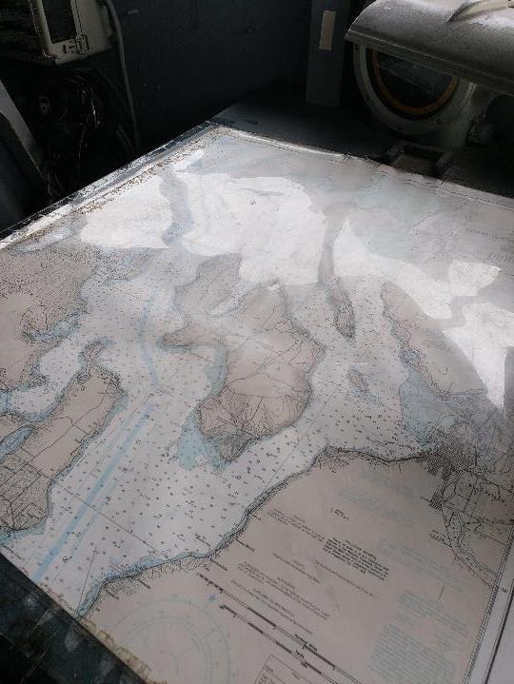
Project Management
For School District Supervisors
Colleen Kragen – Safety & Health Specialist

Slide 2
TOPICS
Project Management Definition & Process
5 Stages of Project Management
Tools for a Successful Project
Project Maintenance & Review

Slide 3
Project Management Definition
Projects
Project Management
Temporary – a defined beginning and end in time with set scope and resources
Unique – not a routine operation designed to accomplish a singular goal
The application of knowledge, skills, tools, and techniques to meet the project requirements

Slide 4
Advantages
Complete Understanding
Basic Understanding
Uncertainty
Probability & Prediction
Complete Certainty
Applying Project Management to Operations & Maintenance
Setting expectations for supervisors and workers
Records retention and compliance
More accurate estimates on future projects
Support for more resources
Notes:
Image retrieved from https://strategicppm.wordpress.com/2011/01/31/managing-risk-part-1/

Slide 5
10 areas of knowledge necessary for project management
Cost
Human Resources
Communications
Risk Management
Stakeholders
Procurement
Quality
Integration
Time
Scope
Project

Slide 6
8 Common Project Management Mistakes According to author Jennifer Schiff at CIO business & technology magazine
1. Not meeting with the whole team
2. Not Breaking down the project into pieces
3. Forget to people manage
4. Not prioritizing projects/tasks
Have representatives from each department or shift that will be involved and set goals upfront.
Larger projects require phases to break the whole thing into manageable smaller pieces.
While checking in on project schedules and budgets it is important to see how the employees are doing as well.
There are often concurrent projects and supervisors need to be clear about what the priorities are.
Notes:
Article retrieved from https://www.cio.com/article/2391872/8-common-project-management-mistakes-and-how-to-avoid-them.html

Slide 7
8 Common Project Management Mistakes According to author Jennifer Schiff at CIO business & technology magazine
5. Not regularly communicating with the team
6. Let changes get out of hand
7. Not using a project management software program
8. Failure to adjust course
Plans evolve constantly, don’t forget to update the team members or let them know how things are going.
As much as plans do evolve use the tools to stay on track, try and minimize changes.
Software tools and spreadsheets help track change and make adjusted schedules and costs.
When things go wrong be flexible.
Notes:
Article retrieved from https://www.cio.com/article/2391872/8-common-project-management-mistakes-and-how-to-avoid-them.html

Slide 8
Project Management Process
Monitor & Control
Close Out
Planning
Conception
Initiate the project
Scope & Budget
Work Schedule
Timeline
Communication Plan
Risk Management
Execution
Status Tracking
Quality Control
Forecasts
Objectives
Deliverables
Effort & Cost Tracking
Performance
Project Punch list
Reporting

Slide 9
Project Management Process – The Big Picture
Notes:
Image from pixabay

Slide 10
Conception
Define the project and set up expectations:
Scope – the project goal that defines everything that will be accomplished by the end of the project
Set Time – a beginning and end date, specific times or at least windows for tasks, check-ins, and buffers
Notes:
Image retrieved from https://www.slpschools.org/Page/2098

Slide 11
The Plan
Timeline – specific times or windows for tasks, check-ins, and buffers
Tasks – list of required steps to reach the project goal
Resources – identify resources available and needed to reach the goal
Projected Budget – man-hours, resource procurement, training, contractors, operational downtime, etc.
Notes:
Image retrieved from https://www.researchgate.net/figure/Project-Management-Planning-Process-Group-7_fig1_269927699

Slide 12
Planning Groups
Develop Project Management Plan
Develop Schedule: define activities, sequence activities, estimate activity resources, estimate activity duration
Communications Management
Risk Management: identify risks, qualitative risk analysis, quantitative risk analysis, risk appetite, risk responses
People Management: stakeholders, employees, contractors
Scope Management: collect requirements, define scope, track events and maintain scope
Cost Management: estimate costs, determine budget, track budget
Quality Management
Notes:
Image retrieved from https://www.researchgate.net/figure/Project-Management-Planning-Process-Group-7_fig1_269927699

Slide 13
Execute the Plan
Notes:
Photo by Helloquence on Unsplash

Slide 14
Monitor the Project
Make sure the execution is in line with the project:
Verify the plan is being followed
Track expenditures – check predicted vs. actual costs
Continually review timelines and project scope to make adjustments where needed and update expectations
Tigger level

Slide 15
Close the Project
Accomplish the Project Goal
What is Needed
Verify all of the required tasks have been completed
Complete reports, budget reviews, and update any changes to the project for historical record
Create a punch list and timeline for unfinished items and update the timeline to include punch list completion estimates.
Deliverables
Documents
Financials
Reports
Transition Support
Resources
Notes:
Image retrieved from https://www.projectmanager.com/

Slide 16
Tools for Project Management

Slide 17
Buffers & Backups
Potentially the most important part of any project is to include buffers (money and time) and backup plans.
It is always better to explain upfront why a project might have higher costs and take longer, than to explain later why are you are over budget and running late.
Historical data can be used to establish realistic buffers
Notes:
Image by algedroid from Pixabay

Slide 18
Worker Hours
There are many software programs that can be used to estimate, track, and verify man-hours spent on a project.
The data can be used to review for areas of strengths and improvement
Data from past projects can also be used to predict needs for future project and set realistic estimates.
Notes:
Image retrieved from http://www.smorad.com/project-man-hours-template/project-forecasting-for-planning-and-earned-valuegement-screenshot/

Slide 19
Resource Analysis
Have
People
Qualifications
Need
Workers
Certificates
Finances
Funds
Fill Gap
Contracts
Training
Grants

Slide 20
Timelines
Need to be manageable and include phases
Notes:
Image retrieved from https://www.slideshare.net/ainun_nadwawh/progress-monitoring-system

Slide 21
Project Budgets
Cost Management
Develop Budget
Benefits
Estimate Costs
Avoid
Control Spending
Creates Project Baseline
Budget Errors
Cost Overrun
Contracts Exceed Estimates
Provides Actions to Stay on Track
Tips:
Add room for unexpected costs
Track real-time to catch issues as they arise
Respond promptly

Slide 22
Project Review

Slide 23
Improving on Success
To continue improving review the project after completion:
What areas worked best?
What issues were unforeseen?
Were problems easily addressed?
Were the buffers sufficient?
What could be done better next time?
Notes:
Photo by Estée Janssens on Unsplash

Slide 24
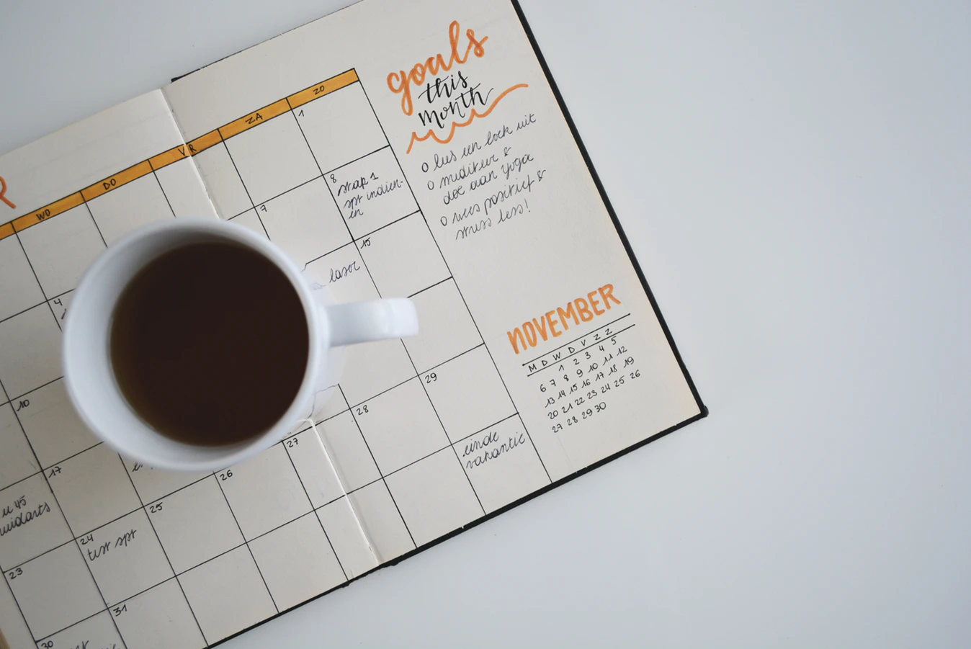
Thank you for your participation!
Colleen Kragen
+1 360-515-8225
ckragen@oesd114.org
https://www.oesd114.org/Page/423

